Slide 1
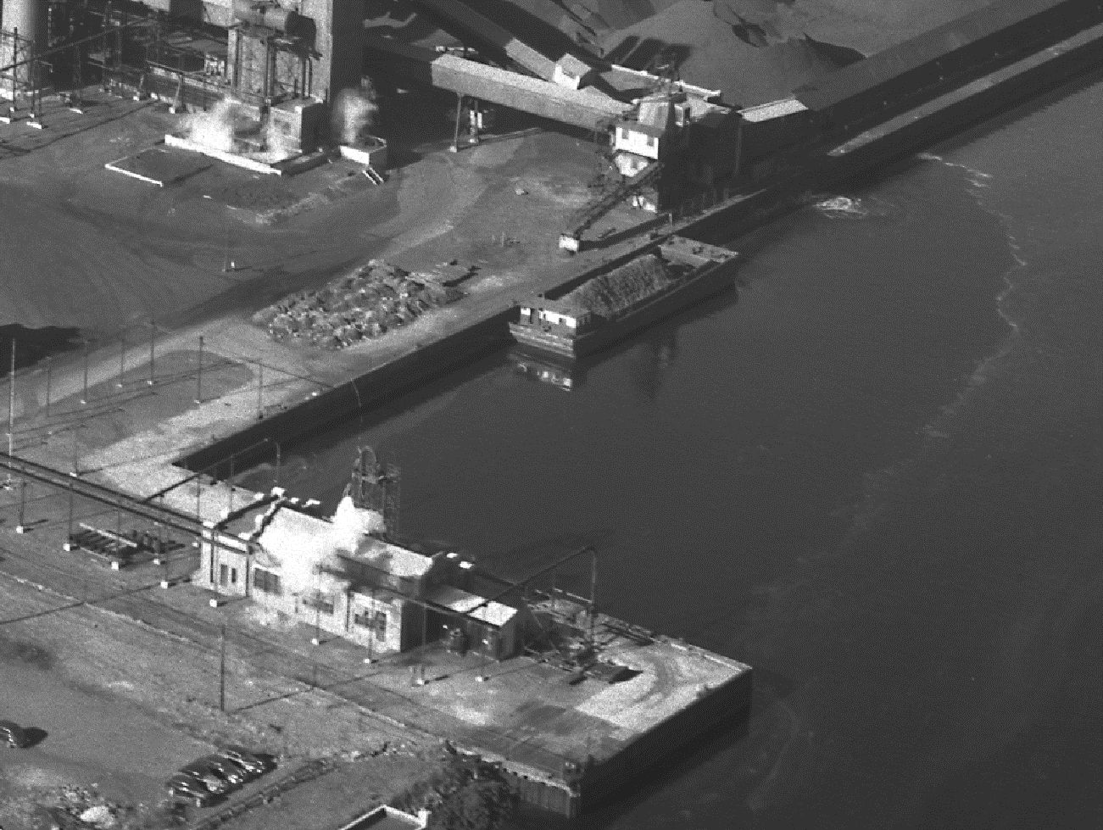
Confirming Laser-Induced Fluorescence NAPL Delineation in Newtown Creek Superfund Site
Shane McDonald, (shane.mcdonald@hdrinc.com) HDR Inc.
Chitra Prabhu, HDR Inc.
Solomon Gbondo-Tugbawa, Louis Berger U.S.
Ron Weissbard, NYCDEP
Randy St. Germain, Dakota Technologies
John Kern, Kern Statistical
Eleventh International Conference on Remediation of Chlorinated and Recalcitrant Compounds
Palm Springs, California
April 8-12, 2018
Session: H3. High-Resolution Site Characterization
Discharge at Brooklyn Union Gas Plant, 1941

Slide 2
Introduction
Why NAPL Delineation?
  Long history of industrial use including petroleum storage and refining and manufactured gas production
  Known releases of both petroleum products and MGP waste to uplands and to creek
  Observations of ebullition facilitated NAPL migration and seepage of NAPL from creek banks
  Observations of NAPL in environmental cores collected for other reasons
  Comprehensive assessment is needed for RI and FS purposes
NYCDEP’s program to delineate NAPL in Newtown Creek
  Laser Induced Fluorescence (LIF)
    TARGOST – Detects high PAH concentration NAPL such as coal tars and heavy oils
    UVOST – Detects lower PAH concentration NAPL such as refined petroleum products
    Fluoresces PAH dissolved in liquid (i.e., in NAPL but not bound to matrix) and potentially organic matter
      Need intrusive investigations to confirm LIF is responding to NAPL and not organic matter
  Coring at a representative number of locations to assess presence of NAPL and constituents in sediment correlated to LIF responses
    Shake testing of sediment samples selected based on LIF results
    Comprehensive chemical analyses of sediments samples

Slide 3
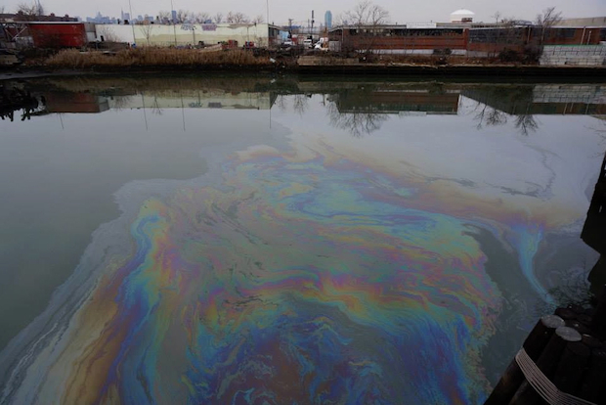
Introduction – Talk Outline
Talk will:
Discuss field methods used by NYCDEP to conduct LIF and LIF – NAPL verification
Discuss statistics and machine learning used to assess LIF’s ability to predict the presence of NAPL and, more importantly, the presence of PAHs ands other constituents at levels of concern
Present a geographic distribution of NAPL based on the LIF survey
Oil slick on Newtown Creek in 1979

Slide 4
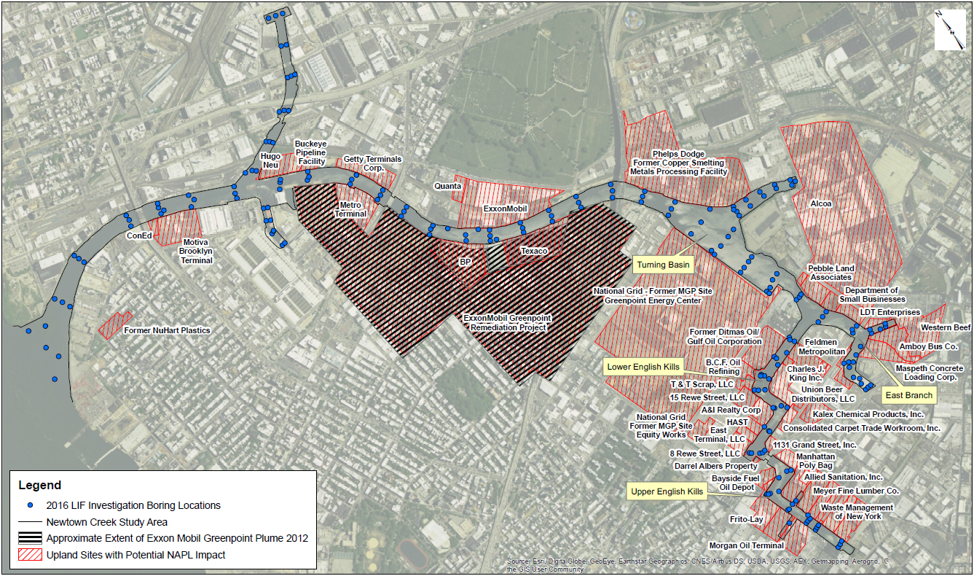
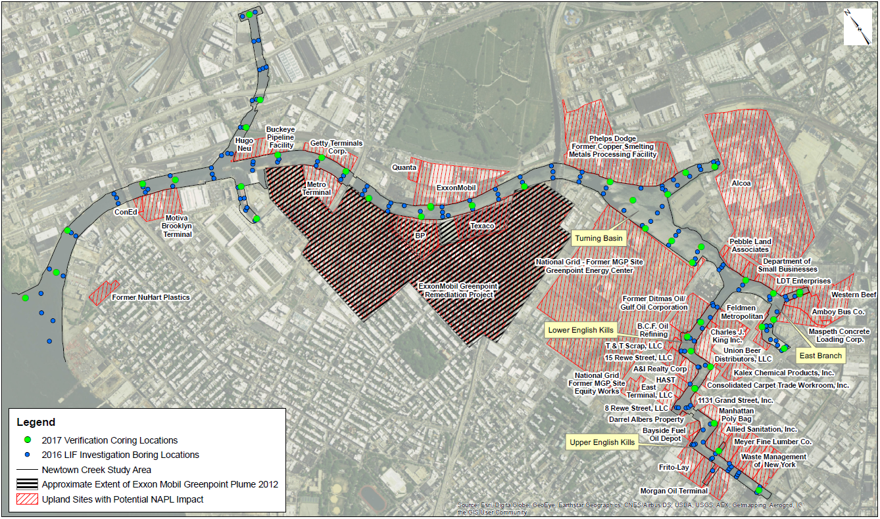
NYCDEP Approach
Queens
180 In situ LIF probes
41 verification cores
200 chemistry - LIF paired samples
Brooklyn

Slide 5
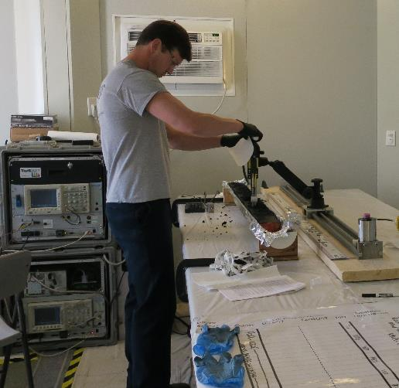
NYCDEP Approach
  Core Logging and photographs – Standardized method of documenting all cores
Sampling Period: June 2017 to July 2017
Sediment cores were collected using Vibracore technology.
Sediment cores were processed in the City processing facility.
LIF responses were measured in the cores ex-situ at every 0.1 feet intervals.
PID measurements were taken every 0.2 feet intervals
LIF responses were used to guide sample selection.
Samples were assessed for
  Shake Test Responses
  PAHs, PCBs, TPH, TOC, Grain Size, metals and VOCs.
Core halves have been archived for future analysis.

Slide 6
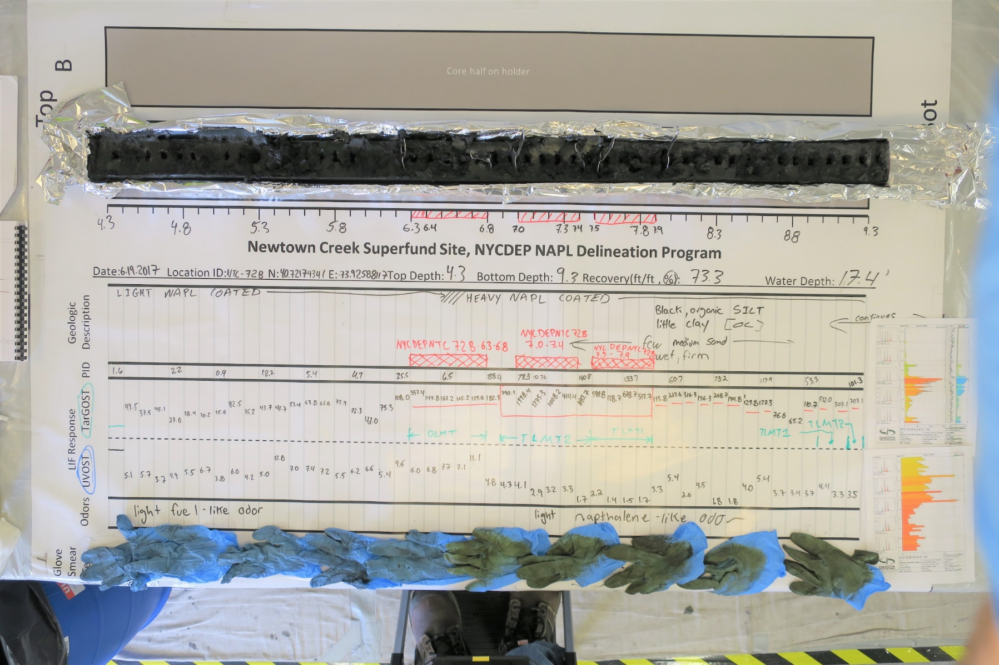
NYCDEP Approach
  Core Logging and photographs – Standardized method of documenting all cores

Slide 7
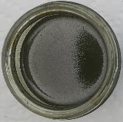
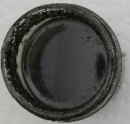
NYCDEP Approach
In Situ TarGOST Log
NTC-15
Shake Test Results
Depth: 7.0’ to 7.5’
Depth: 10.6’ to 11.1’

Slide 8
Predicting NAPL with LIF
Coring to delineate NAPL is expensive and time consuming
In situ LIF presents an alternative to coring for NAPL identification
Machine learning provides quantitative algorithm to identify PAH bearing NAPL
  Methods are repeatable
  Maximize use of information in qualitative descriptions
  Includes quantitative measures of reliability
  Leverages in situ measurements such as LIF
  Improves regulatory acceptance of indirect measures

Slide 9
Petroleum Hydrocarbon Bearing NAPL
(Positive Shake Test + Elevated PAH)
Positive
(Shake Test)
Negative
(Shake Test)
Petroleum
Hydrocarbon Bearing NAPL
Predicting NAPL with LIF

Slide 10
Shake Test Results
Predicting NAPL with LIF

Slide 11
TARGOST Results
False Negative
False Positive
Predicting NAPL with LIF

Slide 12
Comparison to NNLS Identified Signals
Predicting NAPL with LIF

Slide 13
UVOST Results
False Negative
False Positive
Predicting NAPL with LIF

Slide 14
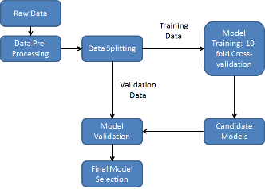
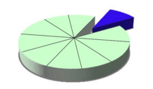
Training Data
Test set
Training data is split into 10 random subsets
Train model on 9 subsets and test on remaining data
Repeat 10 times with a different test set each time
Models identified based on best prediction of Test Set
  Best subsets of variables
  Best algorithms
Predicting NAPL with LIF

Slide 15
Neural Network Algorithm Results
Previous base line method used to identify NAPL where TG Re > 10%
Leveraging machine learning reduced false negative rate by over 60%
Preliminary results developed from 147 samples and are expected to be refined and improved with more data
Predicting NAPL with LIF

Slide 16
Neural Network Algorithm Variable Importance
Relative variable importance determined by creating a model with each individual variable
Quantifying and comparing model accuracy with each variable
No Silver Bullet Variable
Predicting NAPL with LIF

Slide 17
Machine Learning Models for NAPL Delineation
Predict Positive Shake Test
Yes
No
Predicted
tPAH > 100ppm
PAH Bearing NAPL
Not PAH
Bearing NAPL
Yes
No
Predicting NAPL with LIF

Slide 18
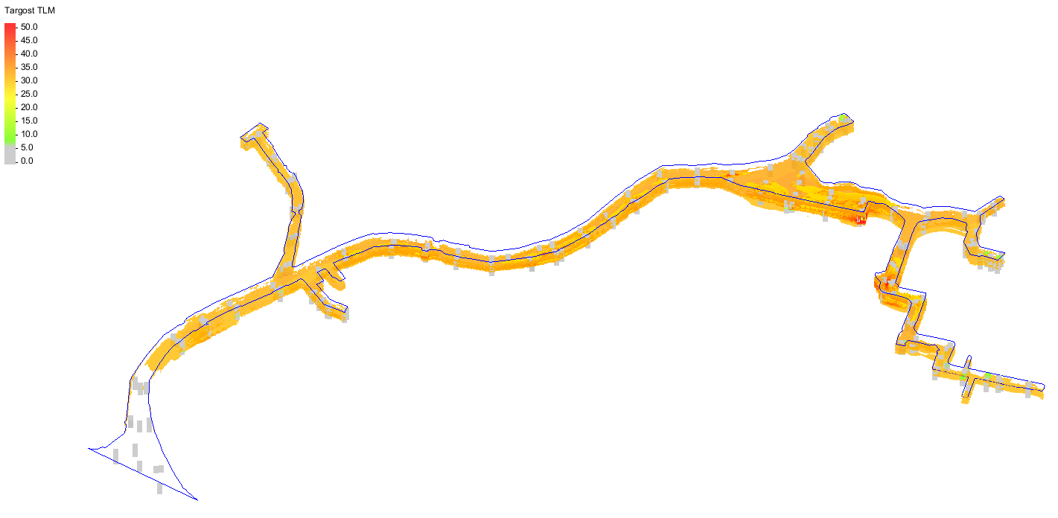
Conclusions
Distribution of TarGOST %RE > 15

Slide 19
Conclusions
  NAPL is extensively present in the sediments of Newtown Creek
  LIF can be correlated to the presence of NAPL and chemical constituents
  Machine learning algorithms will make LIF a robust tool for delineating NAPL in the sediment of Newtown Creek

Slide 20
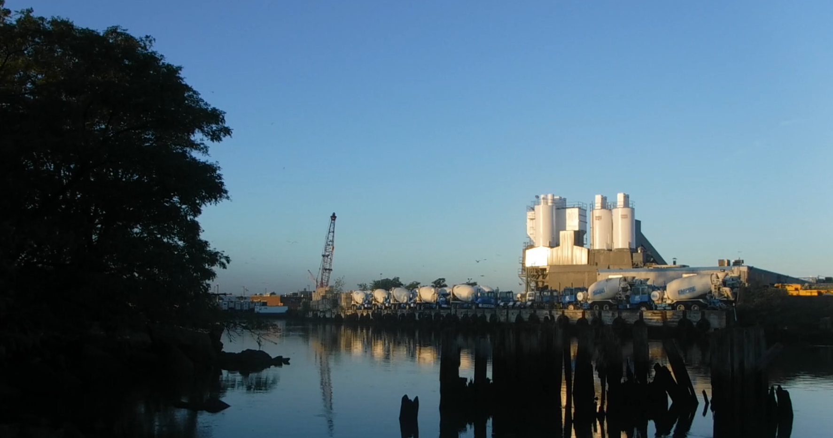
Questions?

