Slide 1

Dr. Eugen Martac, Fugro Germany Land
Batelle Palm Springs 2018
H3. High-Resolution Site Characterization (HRSC)
Newly Developed Aquifer Characterization Procedure
by Means of Hydraulic Profiling Tool and Mini Pump Tests

Slide 2
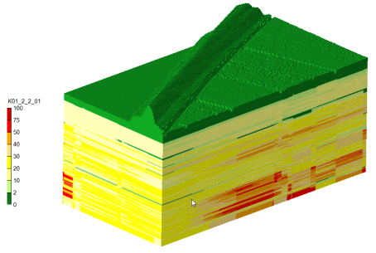
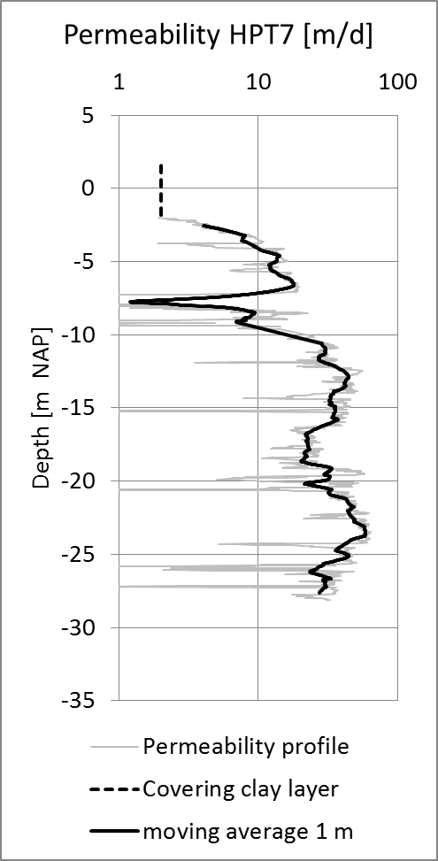
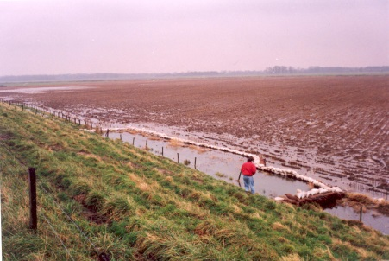
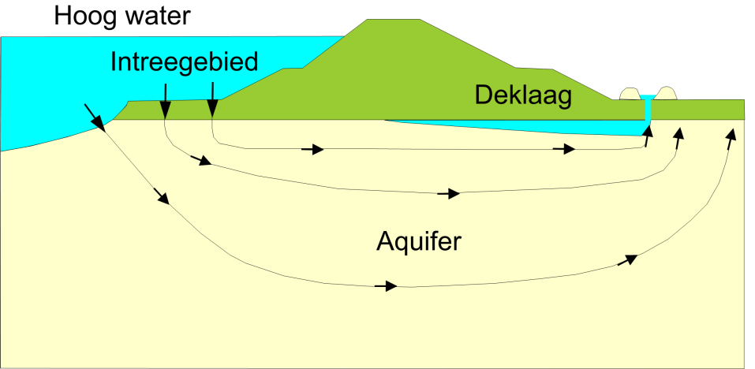
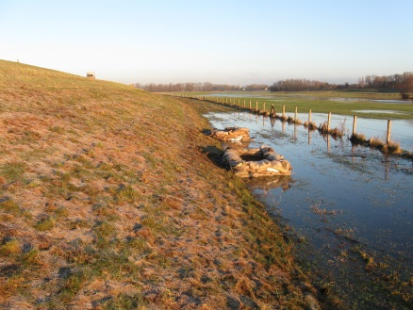
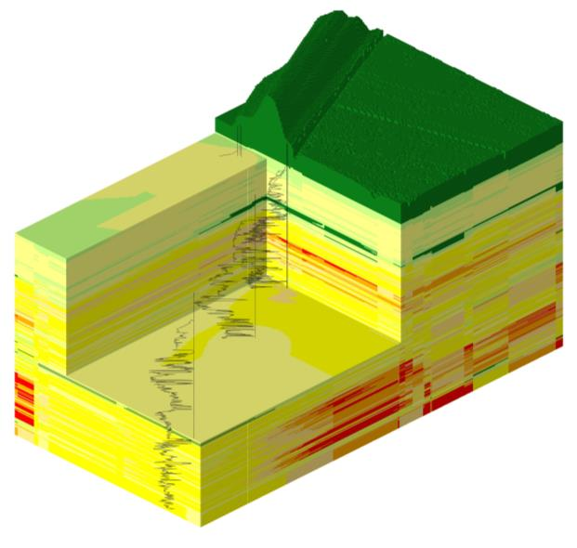
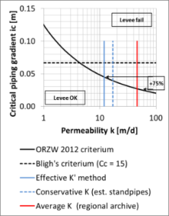
Piping-Analysis based on hydraulic conductivity profiles
Estimation of effective K [K’]
Profiles of hydraulic conductivity
Piping modelling Model calibration to estimate K’-values
Application of K’
in Stability/Piping analysis
Dyke geotechnical remediation

Slide 3
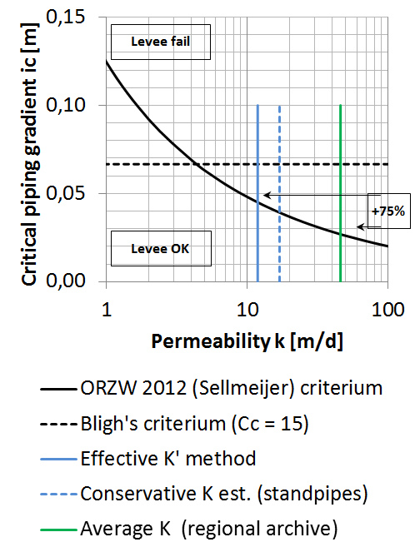
Piping-Stability analysis – case study
Hydraulic conductivity
regional databank K = 45 m/d
(pumping tests averaged over a 10km grid)
conservative estimation K = 17 m/d
(monitoring wells)
HPT/MPT effective K’ = 12 m/d
Important, since HTP/MPT method allows:
- +75% higher critical gradients (ic)
significant lower remediation requirement resp. need to invest

Slide 4
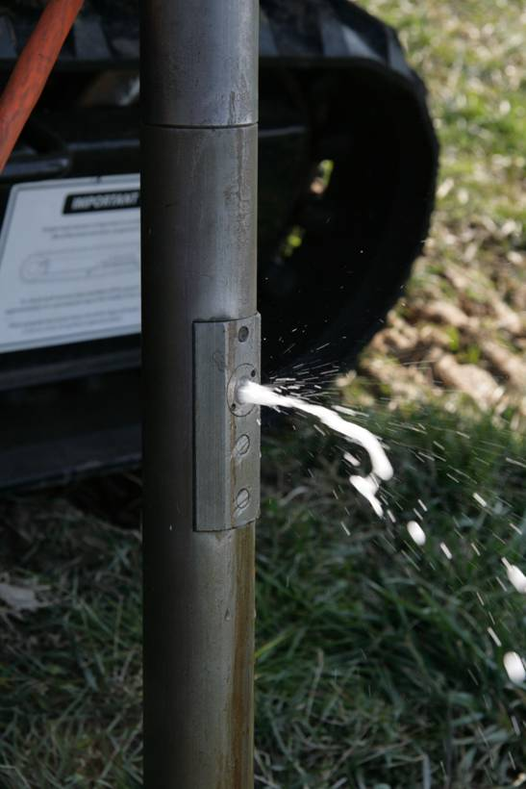
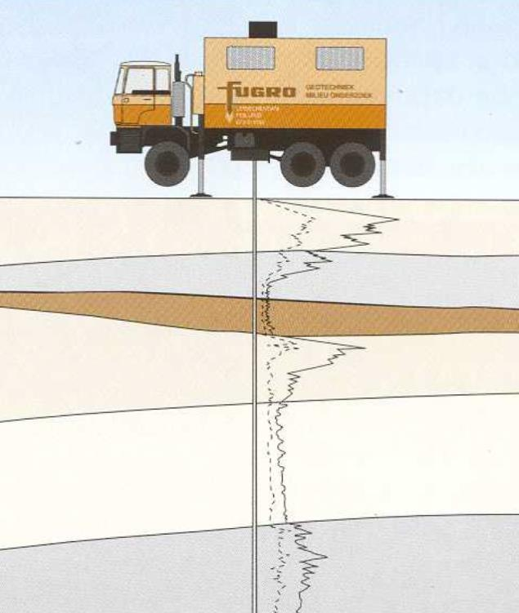
State of the art…
Traditional derivation of hydraulic conductivities:
Empirical methods based on grain size distribution curves
Large scale modeling of aquifer behaviors
Slug-Tests or Pumping tests
Usually only as integral parameter, time and cost intensive derivation!
- Investigation of dyke stability through Cone Penetration Testing (cone resistence and lateral friction)
- Combined derivation of K and S values during CPT will offer significant time/costs advantages!

Slide 5
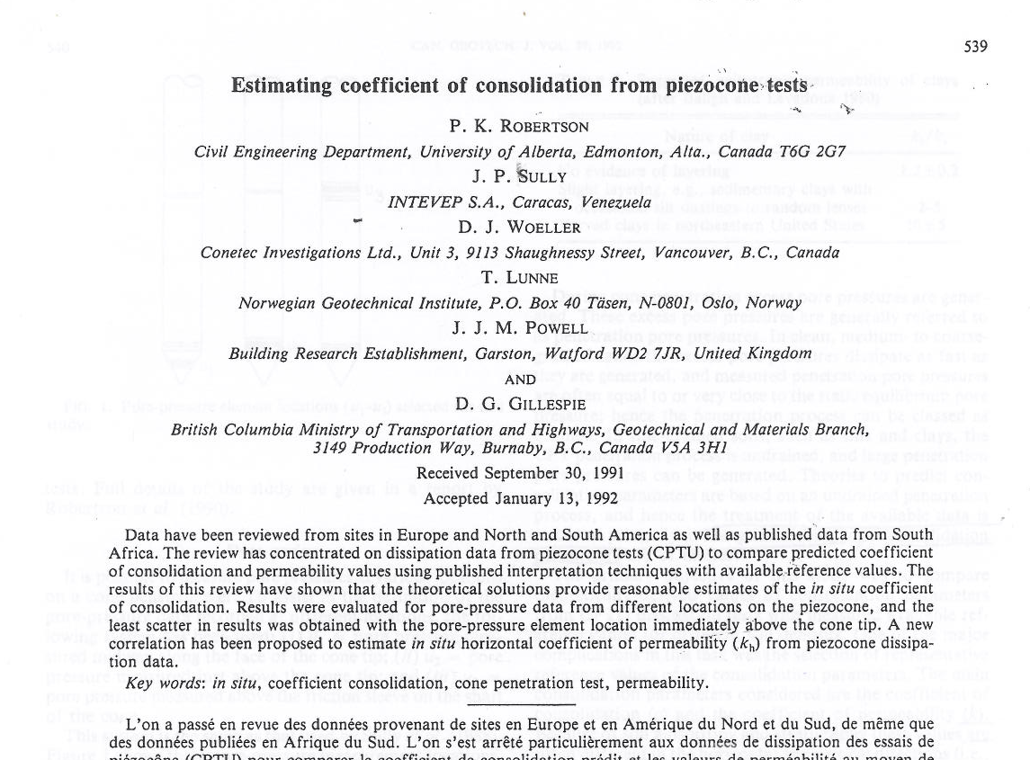
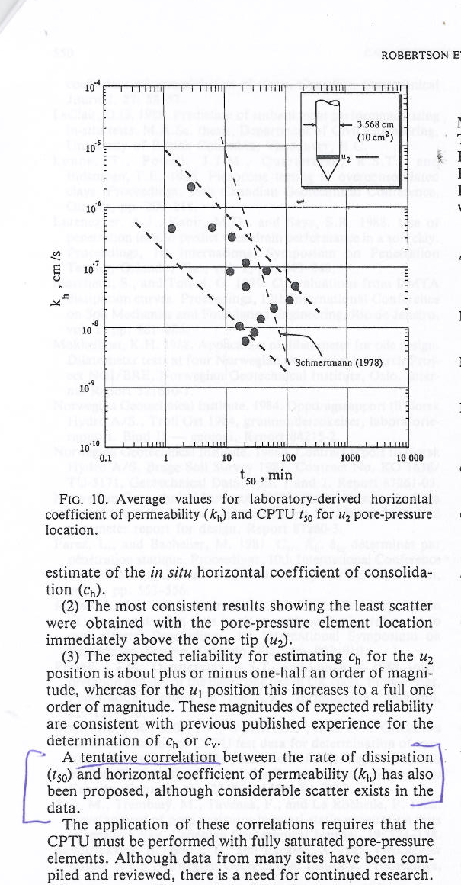
State of the art...
Robertson et al., Can. Geotech. J. Vol. 29, 1992

Slide 6
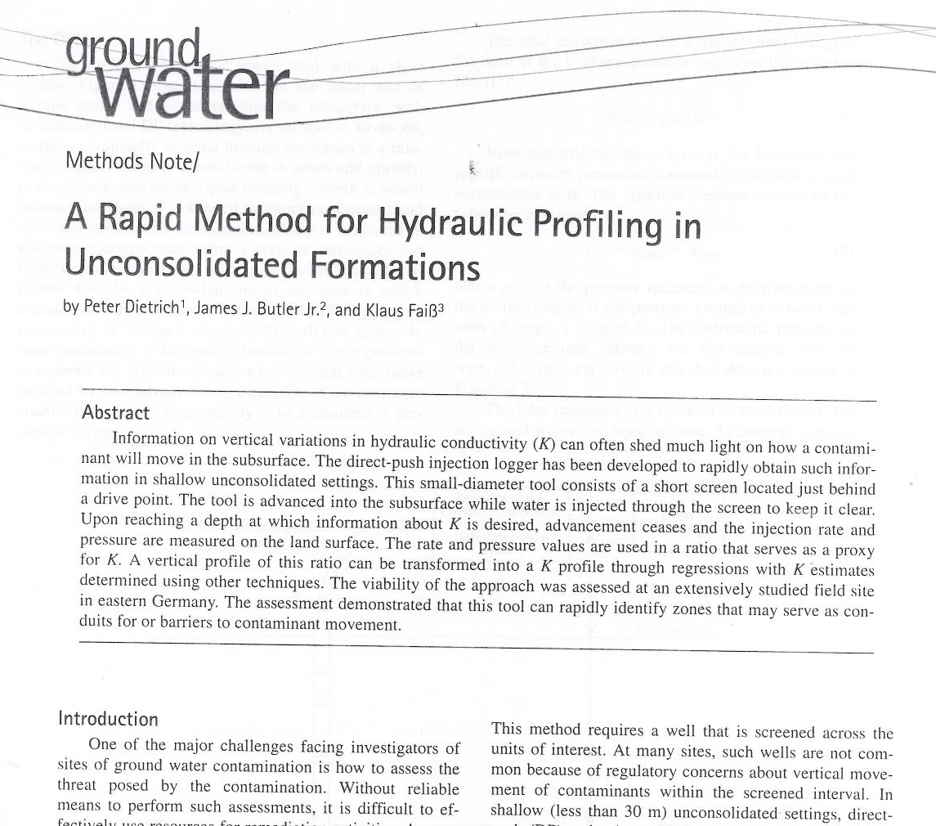
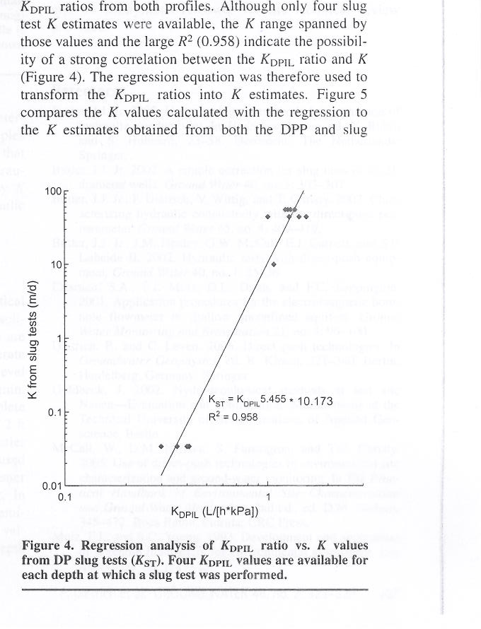
State of the art...
DPIL = direct push injection log
Dietrich et al, Ground Water, Vol. 46, #2, 2008.

Slide 7
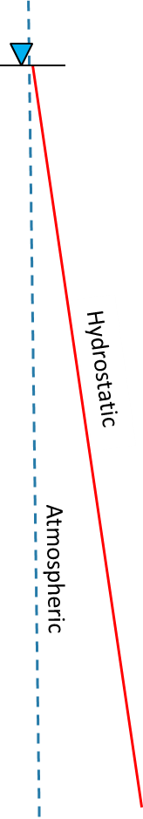
HPT – relative hydraulic conductivity
Hydraulic Profiling Tool by GeopRObe
McCall & Christy 2010
P* = P_{max} – P_{atm} – P_{hydro}

Slide 8
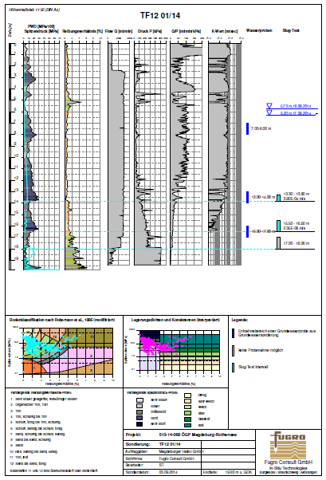
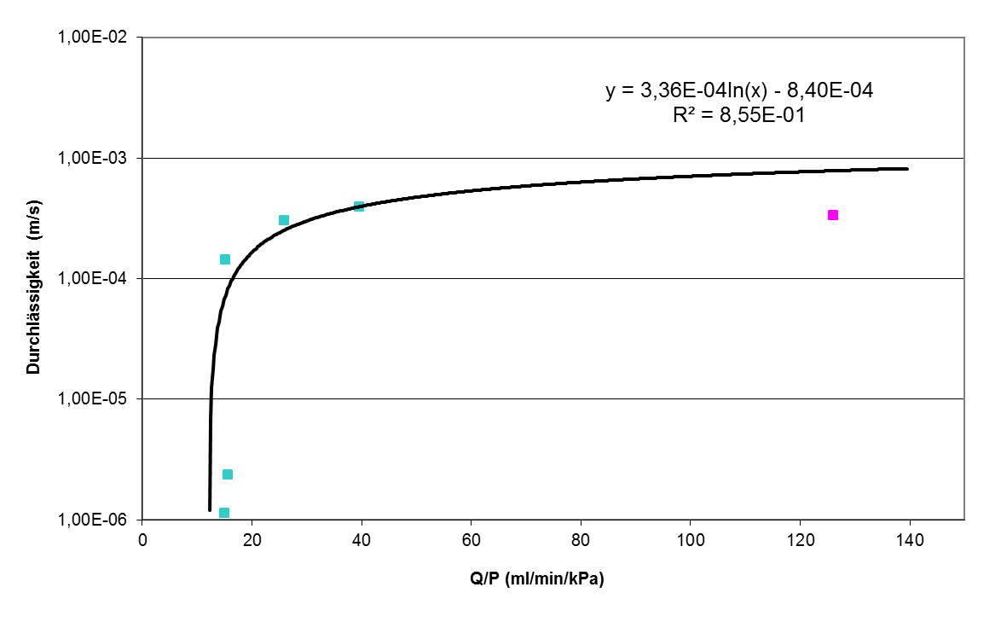
HPT/ST – absolute hydraulic conductivity
-Butler et al., Ground Water 2002
-Liu et al. Ground Water 2008
-Köber et al., Ground Water 2009
-Vienken Th., PhD Thesis, University of Tübingen 2010

Slide 9
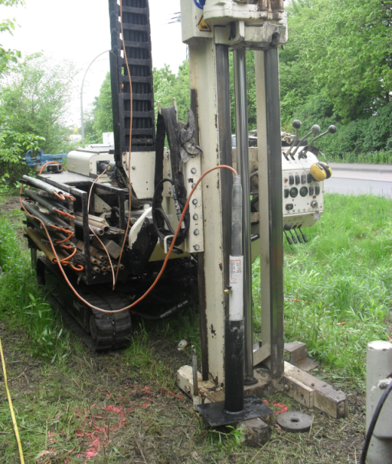
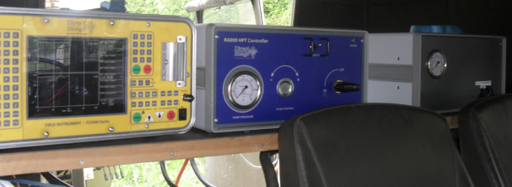
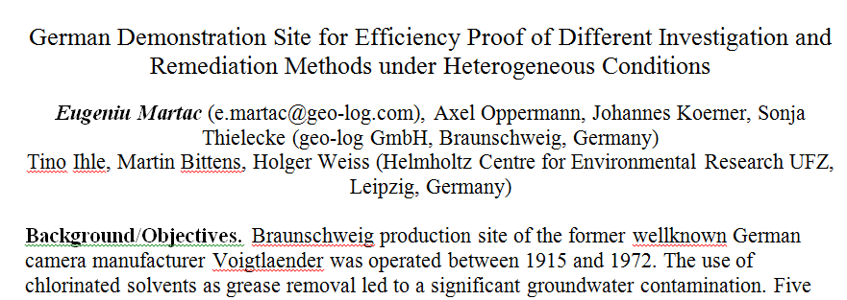
State of the art…
Batelle Chlorinated Hydrocarbons Conference Monterey 2012

Slide 10
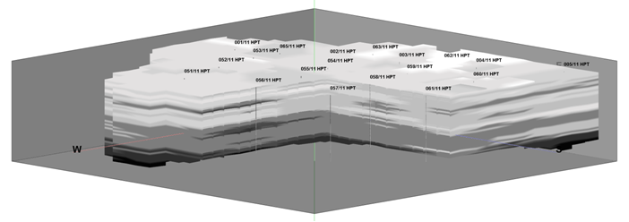
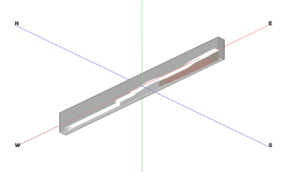
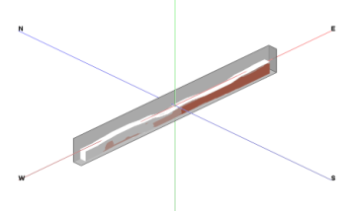
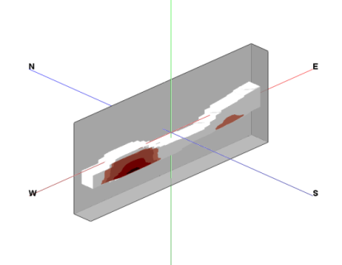
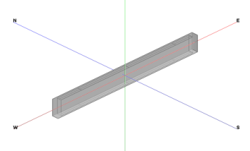
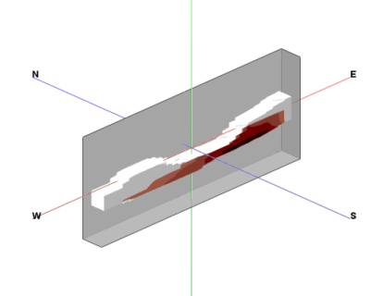

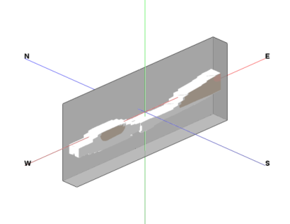
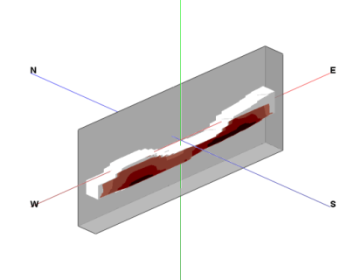
State of the art...
Hydraulic structuring
of the underground
0,0 g/d
Control Plane 2
10,7 g/d
VC
0,0 g/d
Mass discharge
Spatial distribution of mass fluxes
cisDCE
36,9 g/d
12,1 g/d
TCE
136,5 g/d
CHC
0,5 g/d
Batelle Chlorinated Hydrocarbons Conference Monterey 2012
Control Plane 1
174,4 g/d
Mass discharge = Σ_{ij} (c_{ij} . K_{ij} . A_{ij}) . i

Slide 11
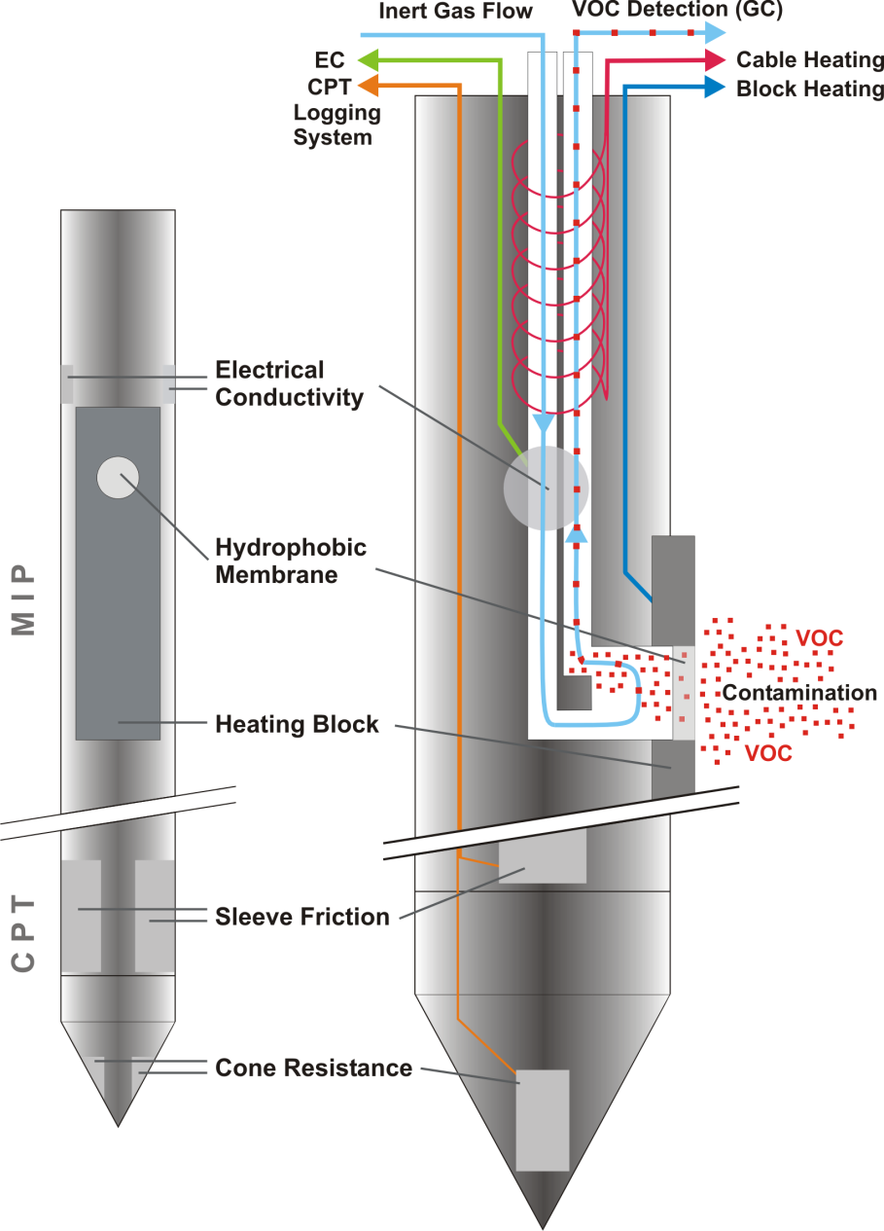
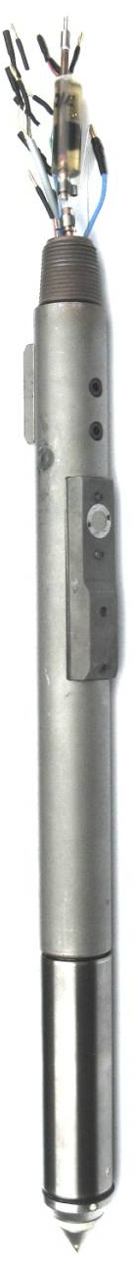
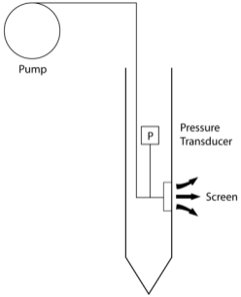
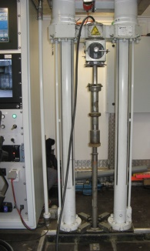
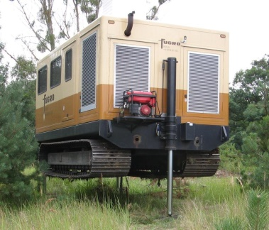
Further development: MIP-HPT-CPT
HPT
Wasser Injektion
MIP-CPT-HPT
HPT = Hydraulic
EC = Lithology + Salinity
MIP = Contamination
CPT = Lithology/Geotechnics
Dynamic pore water pressure
Hydraulic Membrane
Pump (CF)
HPT
Pressure transducer
Filter
Notes:
Möglichkeiten:
Hochauflösende Erfassung = Differenzierung der Kontamination zur Tiefe in Bezug zur Lithologie und Hydraulik.
Echtzeittechnologie = Adaptive Anpassung der Untersuchung = Kosteneffizienz.
Numerische Interpolation der digitalen Messdaten = 3-D Modelle.
Differenzierte Frachtenerfasung = optimierte Risikobewertung und Sanierung.
CPT-Daten und EC-Daten in Kombination lassen Bewertung von anaeroben CKW-Abbauvorgängen zu = Mineralisierung durch Chloridbildung.

Slide 12
MIP-HPT-CPT für complicated sites
AquaConsoil CONFerence
barcelona 2013
Glacial till identified only by friction ratio
Very important information from cone resistance and HPT

Slide 13
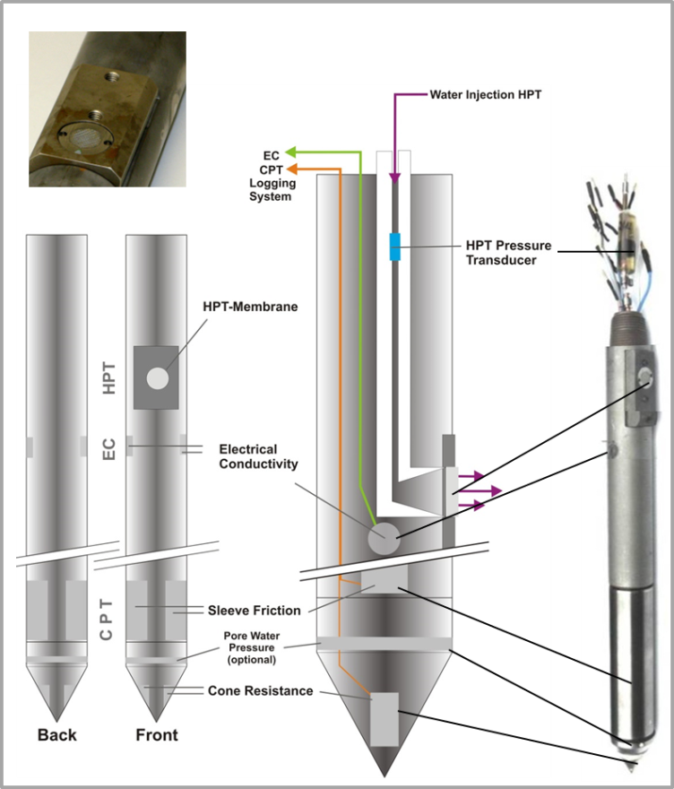
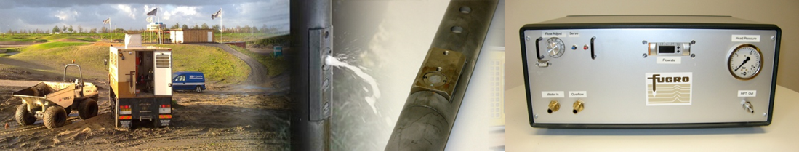
Further development: Power-HPT
Batelle Chlorinated Hydrocarbons Conference Monterey 2016
Aim: Hydraulic structuring of high permeability media
Estimation of K-values from HPT logs?
Power-HPT
Injection flowrate up to max. 5000 ml/min
Characterization of medium to high permeability horizons

Slide 14
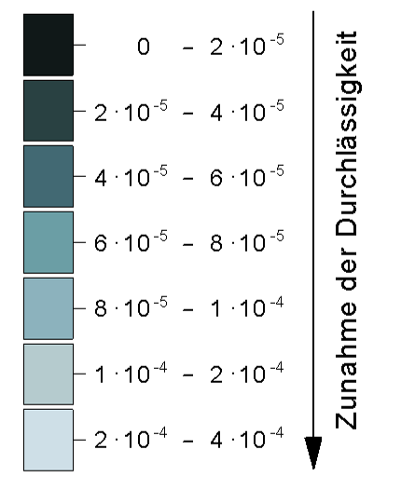
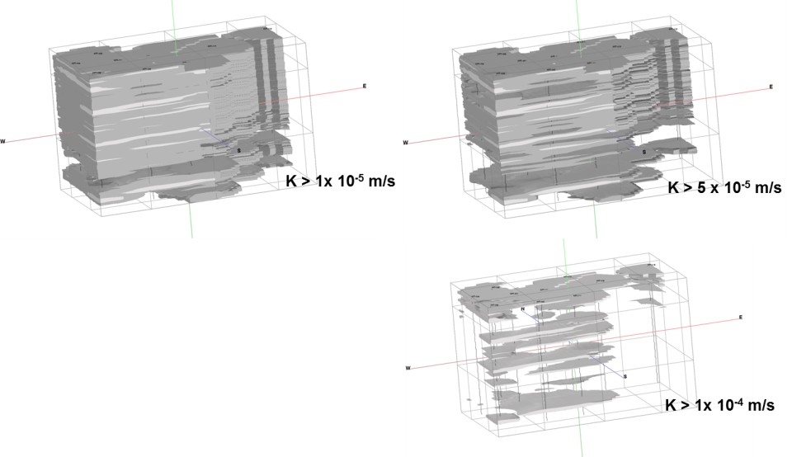
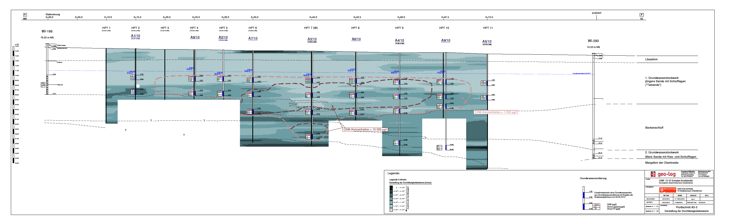
Support method for civil/environmental engineering
Application fields
Identification of dyke weak zones
Water modeling/management
Mass fluxes/mass discharge
Remediation scenarios, etc.
AquaConsoil Copenhagen 2015

Slide 15
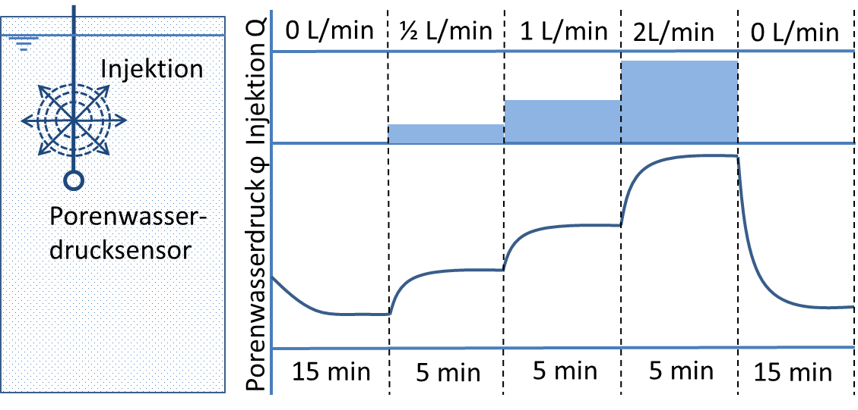
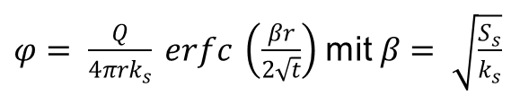
Hydraulic characterization through HPT and MPT
Hydraulic characterization for identification of piping in dykes
K-values(m/s)
> 1 * 10⁻⁴
1 * 10⁻⁵ - 1 * 10⁻⁴
1 * 10⁻⁷ - 1 * 10⁻⁵
< 1 * 10⁻⁷
$φ= \frac{Q}{4πrk_{s}} erfc \left(\frac{βr}{2\sqrt{t}}\right)$ mit $β= \sqrt{\frac{S_{s}}{k_{s}}}$
Φ = Water pressure
Q = Injection flowrate
R = Distance between Injektion port
and pressure transducer
K_{s} = Hydraulic (spherical) conductivity
S_{s} = Storage coefficient
t = Time since injection start
(Bruggemann, 1999)
AquaConsoil Copenhagen 2015

Slide 16
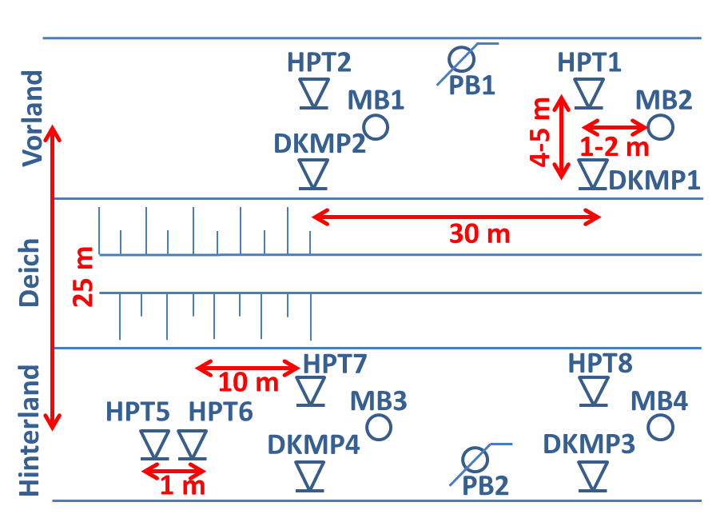
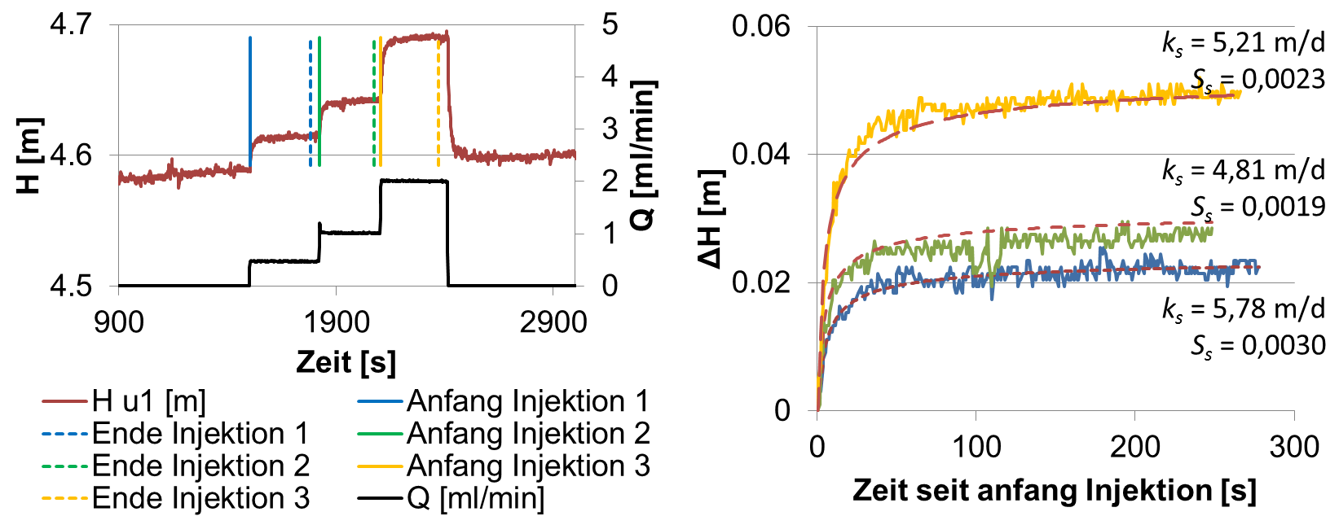
Hydraulic characterization: field deployment
HPT-MPT-CPT example
Aquifer with around 50m thickness
- 0 to 20 m bgl K-values between 10-30 m/d
- 20 to 50 m bgl K-values between 40-60 m/d
Left: u1 Pressure (red) and Injection flowrate (black), Right: inverse modeling of pressure/calibration of K-values

Slide 17
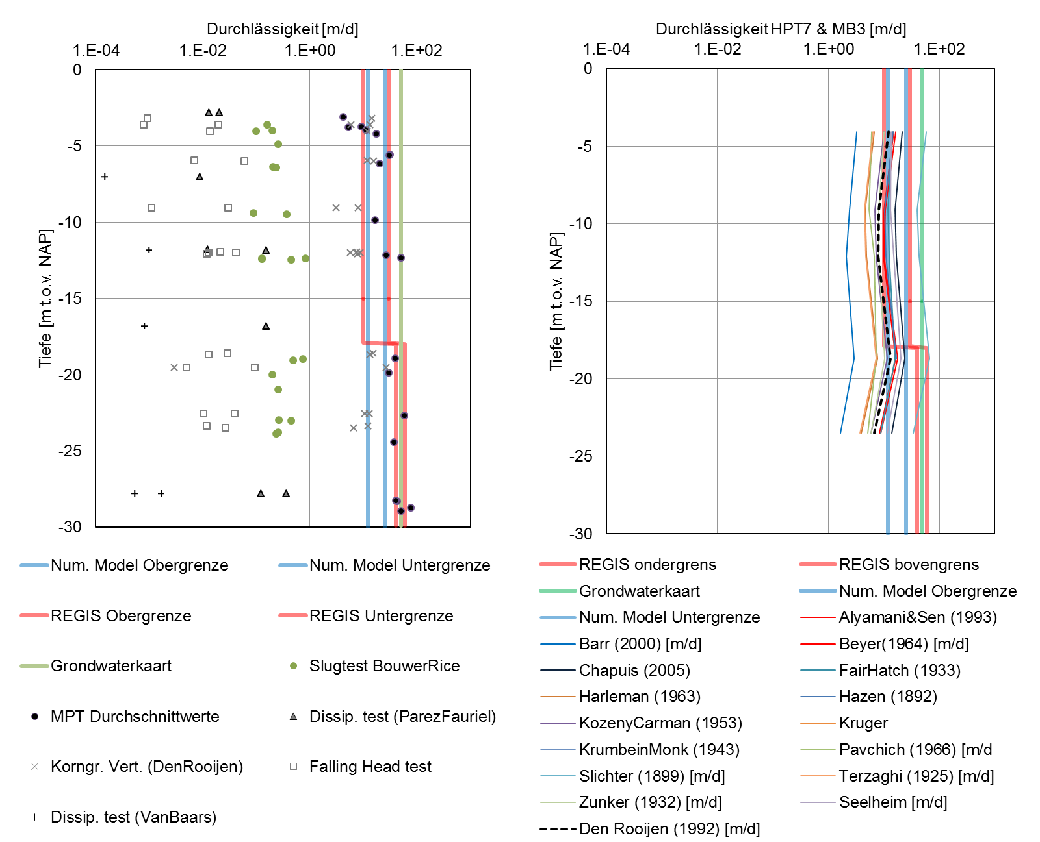
Comparison of different derivation methods
Left: traditional physical derivation of hydraulic conductivity and MPT
Right: empirical derivation of hydraulic conductivity based on grain size distribution models. Large scale tests are displayed with vertical lines (red, blue and green).

Slide 18
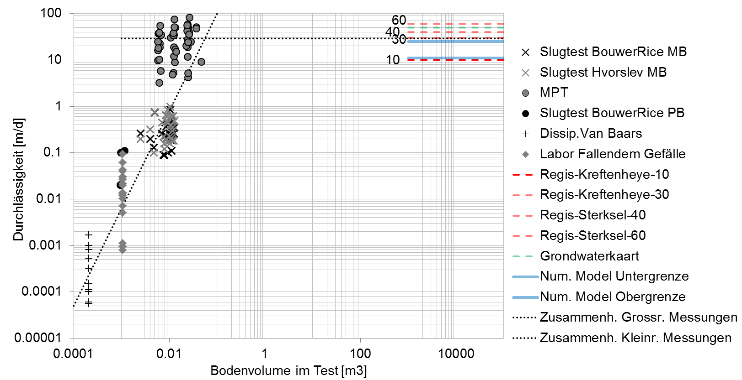
Scale effects of hydraulic conductivity derivation
Hydraulic conductivity versus Representative aquifer volume

Slide 19
HPT/MPT as efficient characterization method
To remember:
Proved system, high efficiency and appricability
R&D towards Channelling vs. Resolution degree
Support methodology for civil/environmental engineering
HPT/MPT method allows a continuous appraisal of hydraulic conductivites during a traditional CPT push
Due to the monitored scale effects of the hydraulic conductivity derivation methods, the HPT/MPT is a much more appropiate method for large scale processes (like pipping) in comparison to small scale lab tests or Slug-Tests
Traditionally recorded geotechnical parameters (cone resistence and lateral friction) are not significantly influenced by the simultaneous use of the HPT/MPT-cone

Slide 20
e.martac@fugro.com
To remember:
Proved system, high efficiency and appricability
R&D towards Channelling vs. Resolution degree
Support methodology for civil/environmental engineering
HPT/MPT method allows a continuous appraisal of hydraulic conductivites during a traditional CPT push
Due to the monitored scale effects of the hydraulic conductivity derivation methods, the HPT/MPT is a much more appropiate method for large scale processes (like pipping) in comparison to small scale lab tests or Slug-Tests
Traditionally recorded geotechnical parameters (cone resistence and lateral friction) are not significantly influenced by the simultaneous use of the HPT/MPT-cone
Thank you!
Questions ?

