Slide 1

Evaluating the Remedial Effectiveness of Four Emulsified Substrates in Anaerobic In situ Bioreactors
Eric J. Raes, P.E., LSRP
Bio-Enhance/E&LP
Dora Taggart, Brett Baldwin, Kate Clark & Anita Biernacki
Microbial Insights Inc.
Kerry Sublette, Ph.D.
University of Tulsa
Notes:
Today I will be talking about a new type of bioreactor that can be deployed in existing groundwater monitoring wells to enhance aerobic or anaerobic biodegradation of contaminants in the aquifer. It is called the Bio-Sep In Situ Bioreactor (Bio-Sep ISBR) . As you will see this technology has it origins in the “bio-trap” which has been used successfully all over the world for forensic analysis of microbial communities in contaminated groundwater as well as many other applications. So this is the story of an analytical tool with a long history moving into the world of remediation.

Slide 2
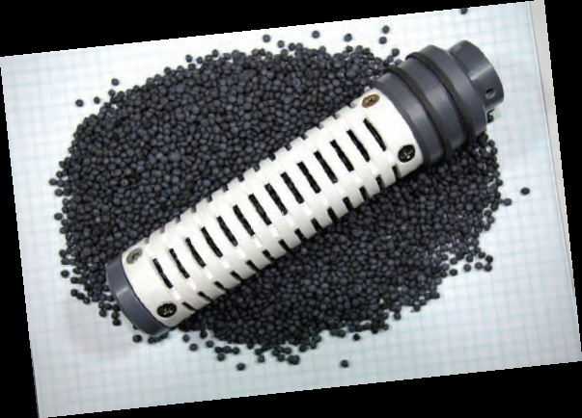
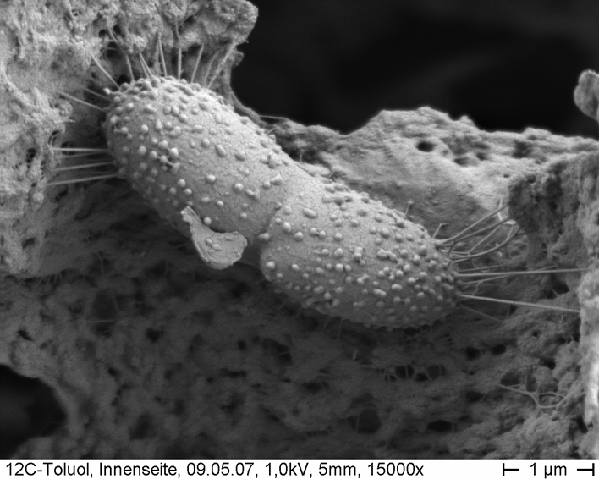


In the beginning…..
Bio-Trap® Sampler with Bio-Sep® Beads
X-Section of Bio-Sep® Bead
Interior of Bio-Sep® Bead
Nomex and PAC
The Bio-Trap® Sampler:
Rapidly colonized by indigenous bacteria forming active biofilms
Thousands used worldwide for over a decade for forensic analysis of groundwater microbiology
Cell division inside of Bio-Sep® Bead within a Bio-Trap Sampler
Notes:
Are you familiar with the Bio-Trap sampler marketed by Microbial Insights? The heart of the Bio-Traps are Bio-Sep beads. Made of PAC and Nomex Bio-Sep beads are rapidly colonized by indigenous microorganisms that are actively involved in the microbial ecology of a sampled environment. There have been thousands of these Bio-Traps deployed all over the world for over a decade making the Bio-Trap a premier forensic tool in the environmental industry.

Slide 3
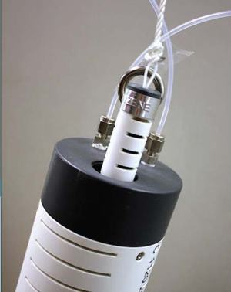
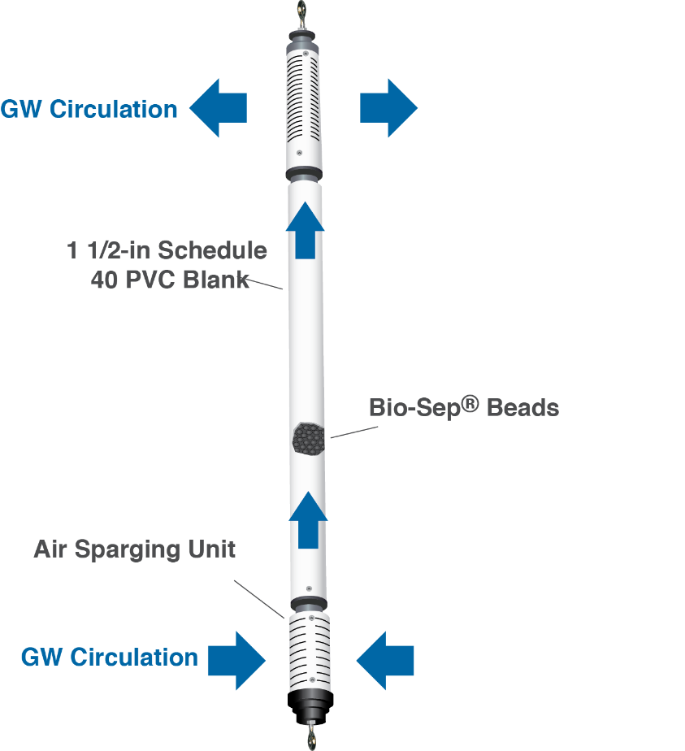
Bio-Enhance ISBR
Nutrientsupply
N₂

Slide 4
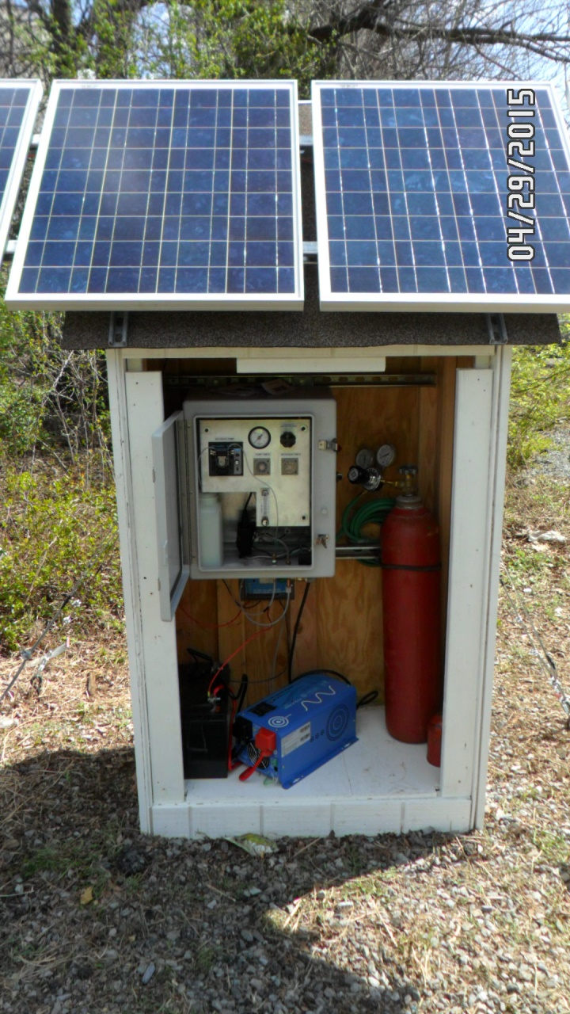
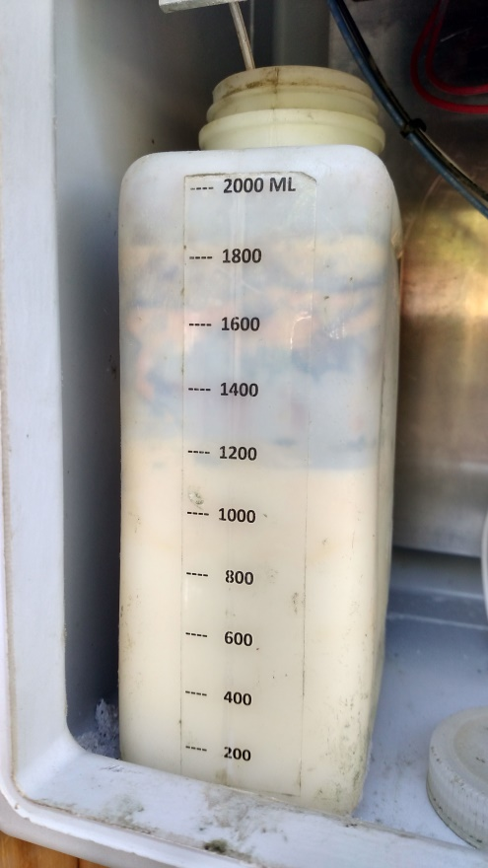
Solar panels power the pump
N₂ supply
Liquid carbon donor (nutrient)

Slide 5
BioEnhance® ISBR Applications
Petroleum Hydrocarbons
  Aerobic
  Anaerobic
Chlorinated Solvents
  Anaerobic
Fuel Oxygenates (MTBE, TBA)
Emerging Contaminants (1,4-Dioxane)
Notes:
But the Bio-Sep ISBR goes beyond making it easier to implement bioremediation in situ. The Bio-Sep ISBR also overcomes two of the common limitations of bioremediation in groundwater, low contaminant concentrations and substrate inhibition. It is a common occurrence in in situ remediation of groundwater to have one or two wells with persistent low concentrations of contaminant. Low concentrations of contaminants can be difficult to biodegrade because a threshold concentration is required to support growth of the degraders. Another potential issue in in situ bioremediation of groundwater is very high contaminant concentrations that can inhibit growth and slow biodegradation. In addition to simply making it easier to implement in situ bioremediation the Bio-Sep ISBRs can help you address both of these common limitations.

Slide 6
BioEnhance® ISBR Applications
Petroleum Hydrocarbons
  Aerobic
  Anaerobic
Chlorinated Solvents (PCE & daughter products)
  Anaerobic
Fuel Oxygenates (MTBE, TBA)
Emerging Contaminants (1,4-Dioxane)
Notes:
But the Bio-Sep ISBR goes beyond making it easier to implement bioremediation in situ. The Bio-Sep ISBR also overcomes two of the common limitations of bioremediation in groundwater, low contaminant concentrations and substrate inhibition. It is a common occurrence in in situ remediation of groundwater to have one or two wells with persistent low concentrations of contaminant. Low concentrations of contaminants can be difficult to biodegrade because a threshold concentration is required to support growth of the degraders. Another potential issue in in situ bioremediation of groundwater is very high contaminant concentrations that can inhibit growth and slow biodegradation. In addition to simply making it easier to implement in situ bioremediation the Bio-Sep ISBRs can help you address both of these common limitations.

Slide 7
Case Study
ISBRs using different commercial emulsified vegetable oils (EVOs)
8 ISBRs installed with direct EVO feed
  ISBRs operated in duplicate fed 1 of 4 commercial sources of emulsified vegetable oil/substrates during incubation (RIPs 1-8) (1L/month of 1/5 dilution EVO)
Two wells bio-augmented along with EVO feed
  One ISBR pre-amended with commercially non-indigenous microbial culture (RIP-9)
  Traditional batch injection (EVO followed by commercial culture after 2 weeks of incubation) in RIP-10. No ISBR.
Study not idealized, i.e. different conditions in different wells. Treatment initiated 3/14/18
Notes:
But the Bio-Sep ISBR goes beyond making it easier to implement bioremediation in situ. The Bio-Sep ISBR also overcomes two of the common limitations of bioremediation in groundwater, low contaminant concentrations and substrate inhibition. It is a common occurrence in in situ remediation of groundwater to have one or two wells with persistent low concentrations of contaminant. Low concentrations of contaminants can be difficult to biodegrade because a threshold concentration is required to support growth of the degraders. Another potential issue in in situ bioremediation of groundwater is very high contaminant concentrations that can inhibit growth and slow biodegradation. In addition to simply making it easier to implement in situ bioremediation the Bio-Sep ISBRs can help you address both of these common limitations.

Slide 9
Monitoring & Analysis
Chlorinated Ethenes & Ethanes
qPCR (MI Quant Array) for taxonomic and functional genes related to reductive dehalogenation
Methane, Ethene, Ethane and Ions
Notes:
But the Bio-Sep ISBR goes beyond making it easier to implement bioremediation in situ. The Bio-Sep ISBR also overcomes two of the common limitations of bioremediation in groundwater, low contaminant concentrations and substrate inhibition. It is a common occurrence in in situ remediation of groundwater to have one or two wells with persistent low concentrations of contaminant. Low concentrations of contaminants can be difficult to biodegrade because a threshold concentration is required to support growth of the degraders. Another potential issue in in situ bioremediation of groundwater is very high contaminant concentrations that can inhibit growth and slow biodegradation. In addition to simply making it easier to implement in situ bioremediation the Bio-Sep ISBRs can help you address both of these common limitations.

Slide 10
cDCE
PCE
TCE
VC

Slide 11
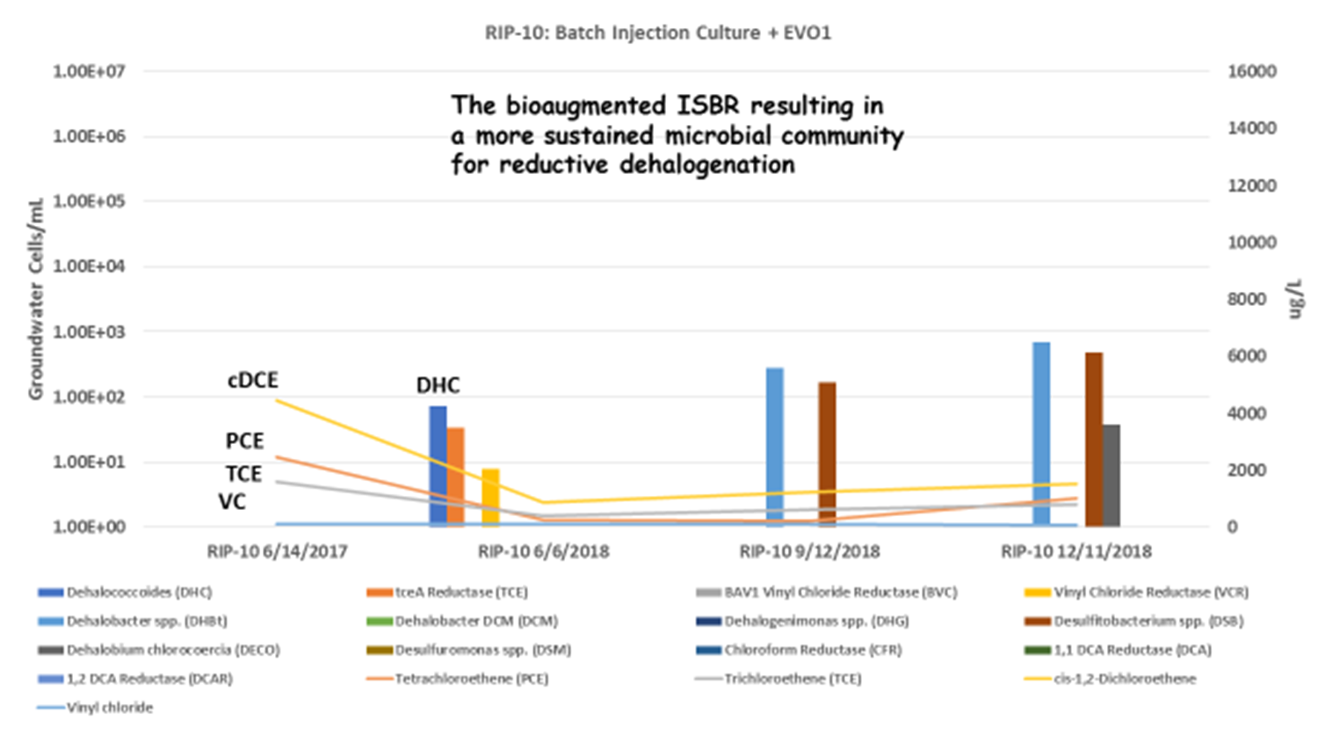

Slide 13
ISBR resulting in sustained indigenous microbial community for reductive dehalogenation

Slide 14
ISBR resulting in sustained indigenous microbial community for reductive dehalogenation

Slide 15
Depleting CVOCs results in decrease in concentrations of degraders

Slide 17
EVO-1 % Mass Reduction PCE

Slide 18
TCE
DHC
PCE
DHC
DHC
cDCE
VC

Slide 19
CVOC concentration reductions by EVO product
Results of ANOVA analysis for first 3 months of treatment
All Data
EVO Product | % Removal of CVOCcs (mean +/- std dev) | Homogenous groups (p< 0.05)
1 | 83.1 +/- 7.8 | a
2 | 85.5 +/- 12.8 | a
3 | 81.5 +/- 16.5 | a
4 | 76.8+/- 23.2 | a

Slide 20
% Mass Reduction – PCE Down Gradient Wells

Slide 21
TCE
DHC
PCE
DHC
DHC
cDCE
VC

Slide 22
Preliminary conclusions
The bioaugmented ISBR has so far resulted in a more sustained microbial community for reductive dehalogenation than traditional injection of EVO and commercial culture
ISBRs without bioaugmentation have resulted in sustained indigenous microbial community for reductive dehalogenation
At 3 months of treatment there was no statistically significant differences in performance of the four commercial EVOs in terms of total CVOC removal
Study will continue for a total of 24 months

Slide 23



Eric Raes
BioEnhance, LLC
eric@bio-enhance.com
(973)219-6185
Kerry Sublette
BioEnhance, LLC
ksublette@microbe.com
(918)691-0639
Notes:
Thank you for your attention. Here is contact information for Eric and Kerry if you need additional information.

Slide 25
ISBR O&M and Costs
O&M
  System checks every 2-4 wks
  Power
  Nutrients/Donor Replenishment
  Water level (ISBR must be totally submerged to function)
Costs
  Life of project rental
    $11,000 for one unit (ISBR and controller)
    $15,000 for two units
    Decreasing per unit costs with addition of more units at a given site
Notes:
The ISBR does require O&M. Check power and amendment levels every 2-4 wks. Make sure the ISBR is submerged. If not, groundwater will not circulate through the Bio-Sep bed. Costs are based on a life of project rental with the cost per unit decreasing with increasing number of units.

Slide 26
INSERT D-16
Notes:
When should you consider an ISBR? Inhibitory concentrations of contaminants, dilute plumes with low but persistent levels of contaminants, and following ISCO to prevent that return trip.

