Slide 1
Performance Assessment of Past Bioremediation Approaches for Chlorinated Solvent Source Zones
Paul B. Hatzinger, PhD
APTIM
April 17, 2019
Collaborators:
Frank Löffler, PhD – University of Tennessee
Mike Annable, PhD and Alex Haluska, PhD – University of Florida
Mark Tucker, PG - APTIM

Slide 2

PROJECT Objectives
Evaluate long term performance of biological treatment of cVOC sources
  Source Reduction
  Plume Reduction
  Contaminant Flux Reduction
  Longevity of Treatment
  MCL Attainment
  Risk Reduction
  Rebound
Identify key factors for predicting treatment success
  Treatment Approach
  Microbial Community Composition
  Initial cVOC Concentrations
  Site Geochemistry
  Site Hydrology/Heterogeneity
  Other Factors
Improved understanding of the long-term behavior of biological treatment approaches for source zones

Slide 3
PROJECT APPROACH
Collect and compile data from ~ 15 sites where bioremediation was used for source area treatment
Develop database consisting of success criteria, remedial approaches, and site characteristics - correlate characteristics & approaches with success
Select 5 sites for assessment of long-term bioremediation effectiveness using the most current tools
  geochemistry and cVOCs
  qPCR (arrays) for key dehalogenating genes/organisms
  Passive flux measurements
  CSIA
Document long-term success or failure and identify key factors

Slide 4
Site Selection Criteria
Source cVOCs > 1 mg/L
Biological treatment applied to remediate source area
Time since treatment (prefer time diversity)
Variety of treatment approaches – bioaug and biostim – different electron donors
Varying site geology and hydrology
Varying geochemistry – pH, initial Eh, conductivity, mineralogy, differing anion levels, etc.
Geography

Slide 5
Sites Selected

Slide 6
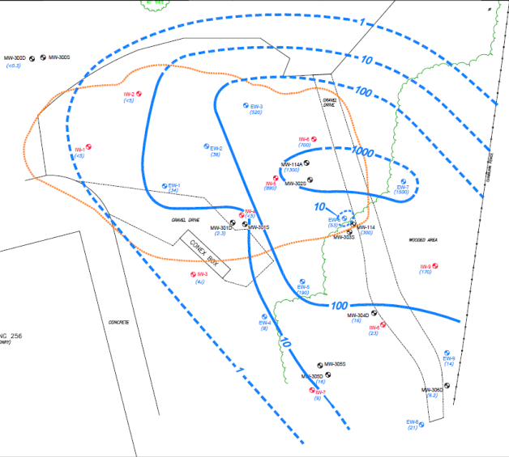
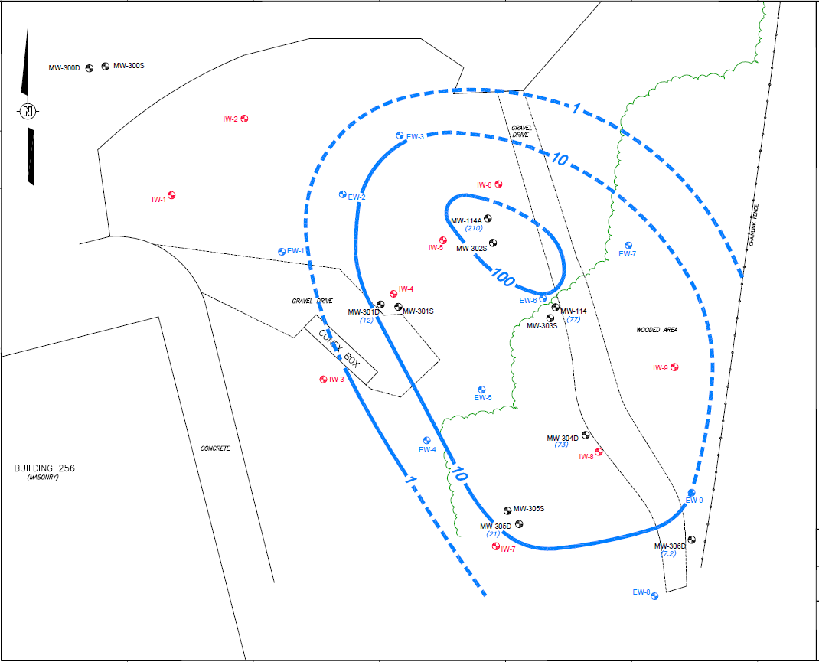
Performance Assessment
Raritan Arsenal Area 18C
Cis-DCE Lower sand unit 2008 and 2010
Vehicle Maintenance Area
3,000 ft plume to ~ 40 ft deep
100 µg/L TCE in 2007 after soil excavation in 1998, but high cis-DCE
Two distinct sandy layers separated by clay/silt
Low pH and mixed ORP
2009: Lower sand – lactate, potassium hydroxide,SDC-9 recirculation, final EVO
2009: Upper sand – EVO direct injection, SDC-9
Overall very good results
Sampled 6 wells – 2 upper sand, 2 lower sand, 2 downgradient - 5.5 years after treatment
CVOCs, Geochemistry; Microbial array; CSIA; PFMs
6

Slide 7
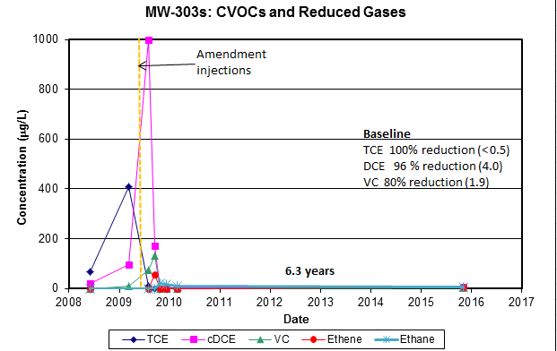
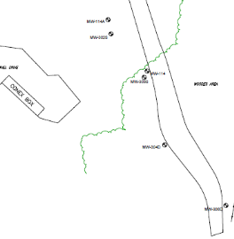
Raritan Arsenal - cVOC data – SHALLOW WELLS

Slide 8
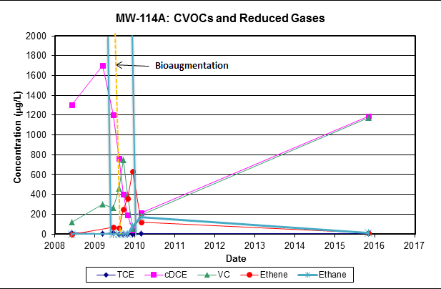
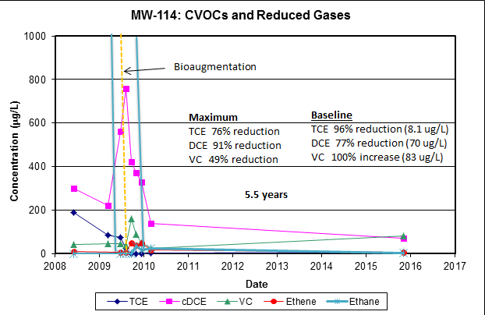
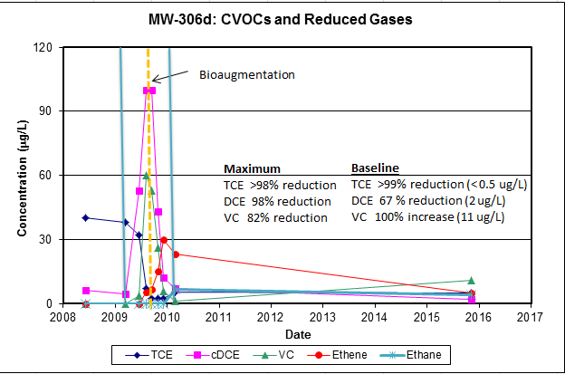
Raritan Arsenal - cVOC data – DEEP WELLS

Slide 9
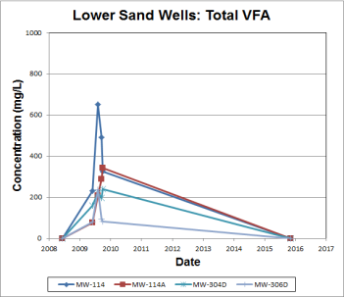
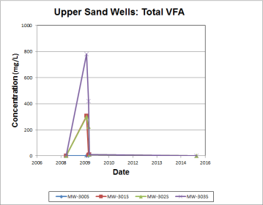
Raritan Arsenal - Supporting DATA
VFA’s ND
ORP 0 to -100 mV
DO 0.1 to 3 mg/L
TOC 3 – 20 mg/L
Methane 0.4 to 6.6 mg/L
Sulfate 5 – 50 mg/L
Nitrate ND

Slide 10
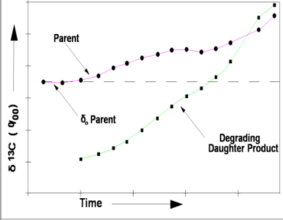
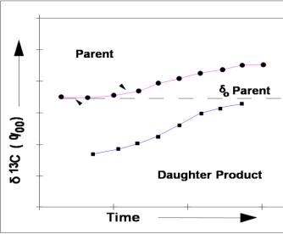
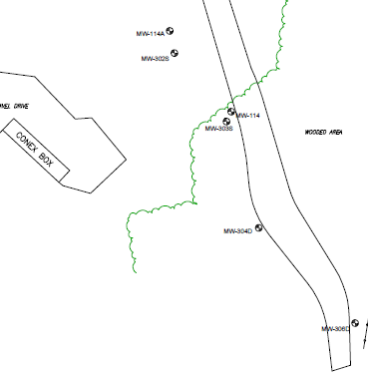
Raritan Arsenal - CSIA data
TCE & cis-DCE - clear evidence of continuing biodegradation in deep zone
δ¹³C significantly heavier in all wells than typical parent TCE (-30 ± 5 ‰)
δ¹³C enrichment with general flow path for TCE
δ¹³C in cis-DCE heavier than TCE & increasing with general flow path
Starting TCE (- 30 ‰)
Starting cis-DCE (-40 ‰)
Well | δ¹³C TCE (‰) | TCE (µg/L) | δ¹³C DCE (‰) | DCE (µg/L)
114 | -20.1 | 8.1 | -8.6 | 70
114A | -18.6 | 6.3 | -8.2 | 1190
304D | -13.4 | 3.5 | -18.6 | 56
306D | NA | < 0.5 | + 22.7 | 4
302S | NA | < 0.5 | NA | < 0.5
303S | NA | < 0.5 | -8.5 | 4
-20.1‰ (6.3 µg/L)
-8.2‰ (1190 µg/L)
-8.6 ‰ (70 µg/L)
-18.6 ‰ (8.1 µg/L)
- 8.5 ‰ (4 µg/L)
-13.4 ‰ (3.5 µg/L)
-18.6 ‰ (56 µg/L)
+ 22.7 ‰ (2 µg/L)
ND (< 0.5)

Slide 11
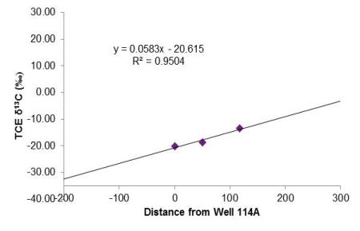
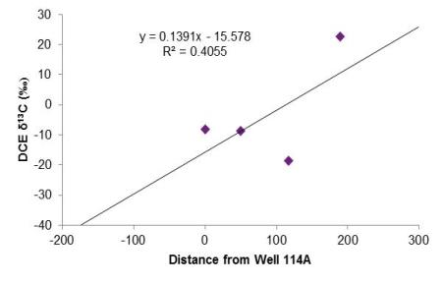
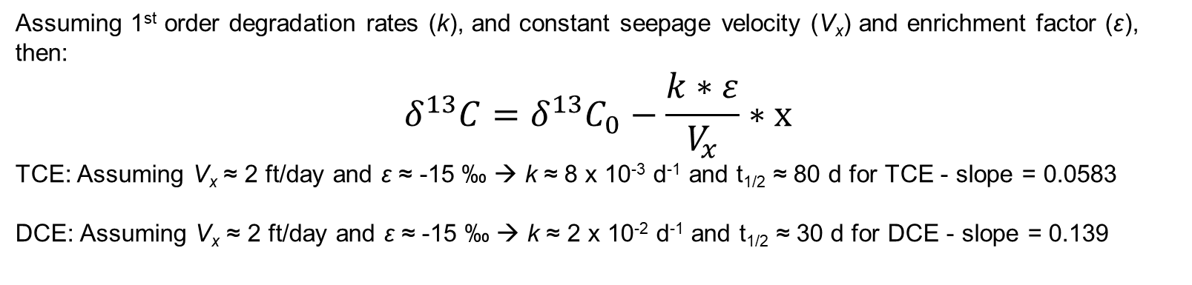
Raritan Arsenal - CSIA data RATE ESTIMATION
Assuming 1st order degradation rates (k), and constant seepage velocity (V_{x}) and enrichment factor (ε), then:
$$δ^{13}C=δ^{13}C_{0}−\frac{k∗ε}{V_{x}}∗x$$
TCE: Assuming V_{x} ≈ 2 ft/day and ε ≈ -15 ‰ → k ≈ 8 x 10⁻³ d⁻¹ and t_{1/2} ≈ 80 d for TCE - slope = 0.0583
DCE: Assuming V_{x} ≈ 2 ft/day and ε ≈ -15 ‰ → k ≈ 2 x 10⁻² d⁻¹ and t_{1/2} ≈ 30 d for DCE - slope = 0.139
TCE
DCE

Slide 12
Raritan Arsenal - Mass Flux data
Primarily cis-DCE and VC flux in deep zone 114A area
Little to no downgradient flux
Some evidence of higher flux near top of formation – near confining layer
MW114A (TCE)
MW114A (DCE)
98% reduction in flux between
114A and 114 (50 ft) for cis-DCE
Equates to an ~ first order degradation rate
of 5 x 10⁻²/day⁻¹

Slide 13
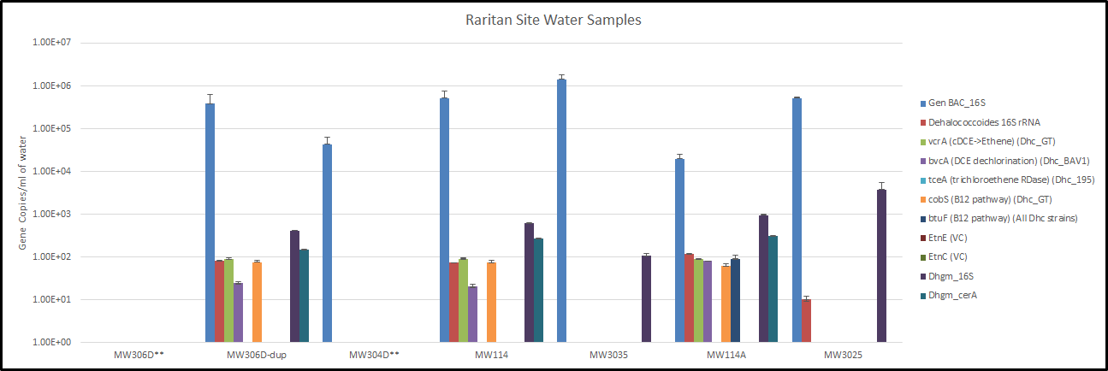
Raritan Arsenal - Microbial Data
** DNA Amplification issue in samples.
Deep Wells – 114, 114A, 306D: Variety of dehalogenating genes present (~ 10⁵/L)
Shallow wells 302S, 303S – no VOCs left, few dehalogenators (Dehalogenimonas only)

Slide 14
Raritan Arsenal - Summary
6 wells re-sampled more than 5.5 years after biotreatment
No rebound shallow zone – Mixed data in deep zone
CSIA and mass flux data suggest continuing biodegradation
Low permeability layer may be slowly leaching cVOCs?
Molecular/gene data generally support assessment
Organisms are persistent after bioaugmentation

Slide 15
All 5 Sites – DHC compiled
DHC show general “hump” pattern based on TCE concentration
  Cells persist over time
  Die-off when cVOC levels decline to low ppb?
  High cVOC sites with no cells?

Slide 16
All 5 Sites – TCE & cis-DCE CSIA compiled
TCE generally shows less fractionation than expected at very low concentration
  Re-partitioning from low permeability layers?
  Threshold effect?
Cis-DCE more consistent fractionation
Product - less re-partitioning from low permeability layers expected?

Slide 17
Database Development
Bioremediation Success?
What are the factors that control success?
Hydrogeology?
Geochemistry?
Treatment approach?
What is the relative importance of each factor?
Are there critical factors for success?
How do you measure success?
Why do some treatments fail?

Slide 18
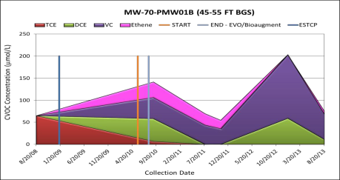
Measures of Effectiveness
Success:
VOC Mass Reduction
Risk Reduction (MCL Multiplier)
MCL Compliance
Dechlorination (chlorine atom removal)
Failure:
Insufficient Mass Removal
Rebound
DCE Stall
VC Accumulation

Slide 19
Success Factors: Site Characteristics
Hydrogeologic:
Hydraulic conductivity
Hydraulic gradient
Seepage velocity
Heterogeneity
Percent Fines
Geochemical (Initial, Min, Max):
pH, DO, ORP
Sulfate, nitrate, chloride, sulfide, iron, manganese
Alkalinity
Methane
Temperature

Slide 20
Success Factors: Treatment Methods
Injection Method
Substrate Used
Bioaugmentation
Nutrients
Dosing
Injection Spacing
Substrate Loading

Slide 21
Data Flow Chart
Site Documents
Front-End
MS Access
Database
190 wells
120,000 Records
Queries
Effectiveness
Matrix
9,000 Cells
ERPIMS
Back-End
SQL Server
Database
15 Sites
6,000,000 Records
Calcs
NIRIS
ERIS
Statistics
Contractor Databases
Spread-sheets
Results!

Slide 22
Statistical Approach
Evaluate statistical correlations between:
  Site characteristics vs. effectiveness measures
  Remediation methods vs. effectiveness measures
Characteristics and methods that affect rebound also evaluated
Assess other correlations of interest
Significant + or - correlations may indicate characteristics or methods that help or hinder remediation

Slide 23
Statistical Methodology
Correlations between numeric parameter pairs - SRO procedure
Nonparametric approach - evaluates monotonic trend, no expectation of linear relationships
SRO yields R, –1.0 to +1.0, indicating goodness of fit to a negative or positive trend
Significance of trend evaluated with p-value at 95% CL
Classification and Regression Tree Analysis (CART)
Procedure to determine relative importance of different variables in a complex dataset
Creates decision tree that predicts characteristics of population studied
Analyzed by Dr. Hunter Anderson, AFCEC

Slide 24
Results – Significant Factors for Mass Reduction

Slide 25
Results – Significant Factors for Rebound

Slide 26
Results – Significant Factors for VC Accumulation

Slide 27
Results – CART ANALYSIS
Evaluated Treatment Success
Assume > 1 ooM reduction is Success
Assume < 1 ooM reduction is Failure
CART analysis relative magnitude of
variables affecting “success” of treatment
Variable | Relative Importance
Percent fines | 1.000
pH | 0.9845
Min sulfate | 0.6417
Seepage vel | 0.6284
Heterogeneity | 0.5503
Bioaugmentation | 0.4844

Slide 28
INTERESTING FINDINGS - DATABASE
    Presence of fine-grained units correlates with success (low fines) as well as rebound (high fines)
    Low hydraulic conductivity correlates with high rebound
    Low sulfate during treatment correlates with success and high sulfate correlates with rebound
    High initial ORP & low initial DHC correlate with VC accumulation
    pH is an important variable affecting success

Slide 29

QUESTIONS
Paul Hatzinger, PhD
Director, Biotechnology Development
APTIM
Paul.hatzinger@aptim.com
  609 895 5356
We wish to acknowledge ESTCP for funding this research.

