Slide 1
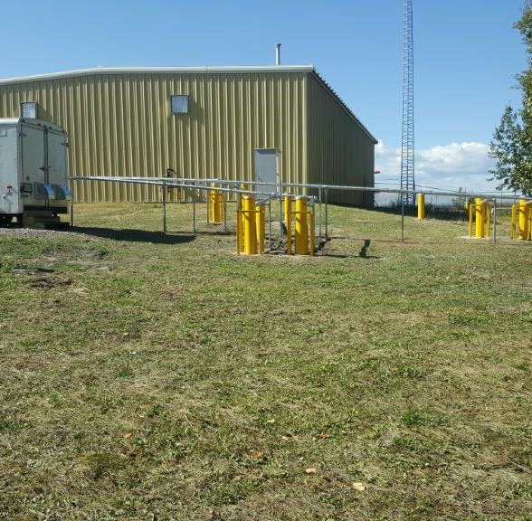


Evaluation of Sulfolane Biodegradation Enhanced using Biosparging in a Fractured Rock Aquifer
Sylvain Hains, Jennifer Harder, Eric Bergeron, Melanie Longpre-Girard, Andrew Madison (Golder Associates Ltd)
Didier Jouen (Imperial Oil Limited), Trent Key (ExxonMobil)
Fifth International Symposium on Bioremediation and Sustainable Environmental Technologies
April 17, 2019

Slide 2
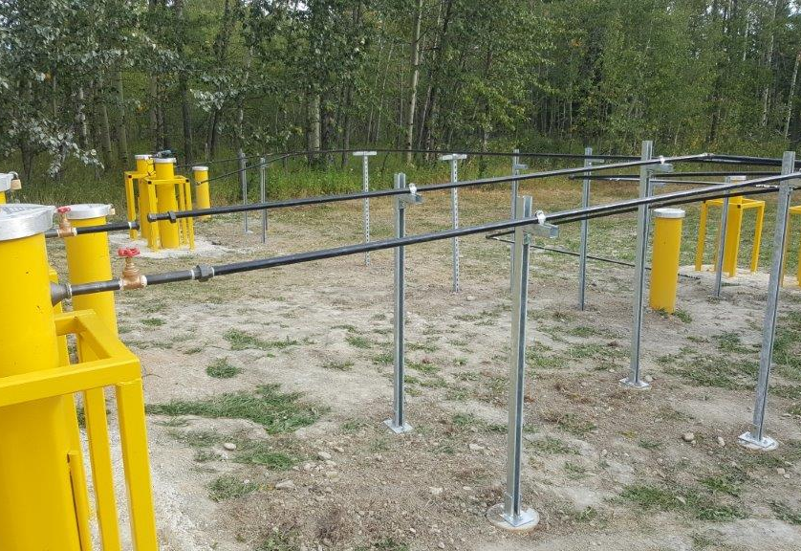
Background

Slide 3
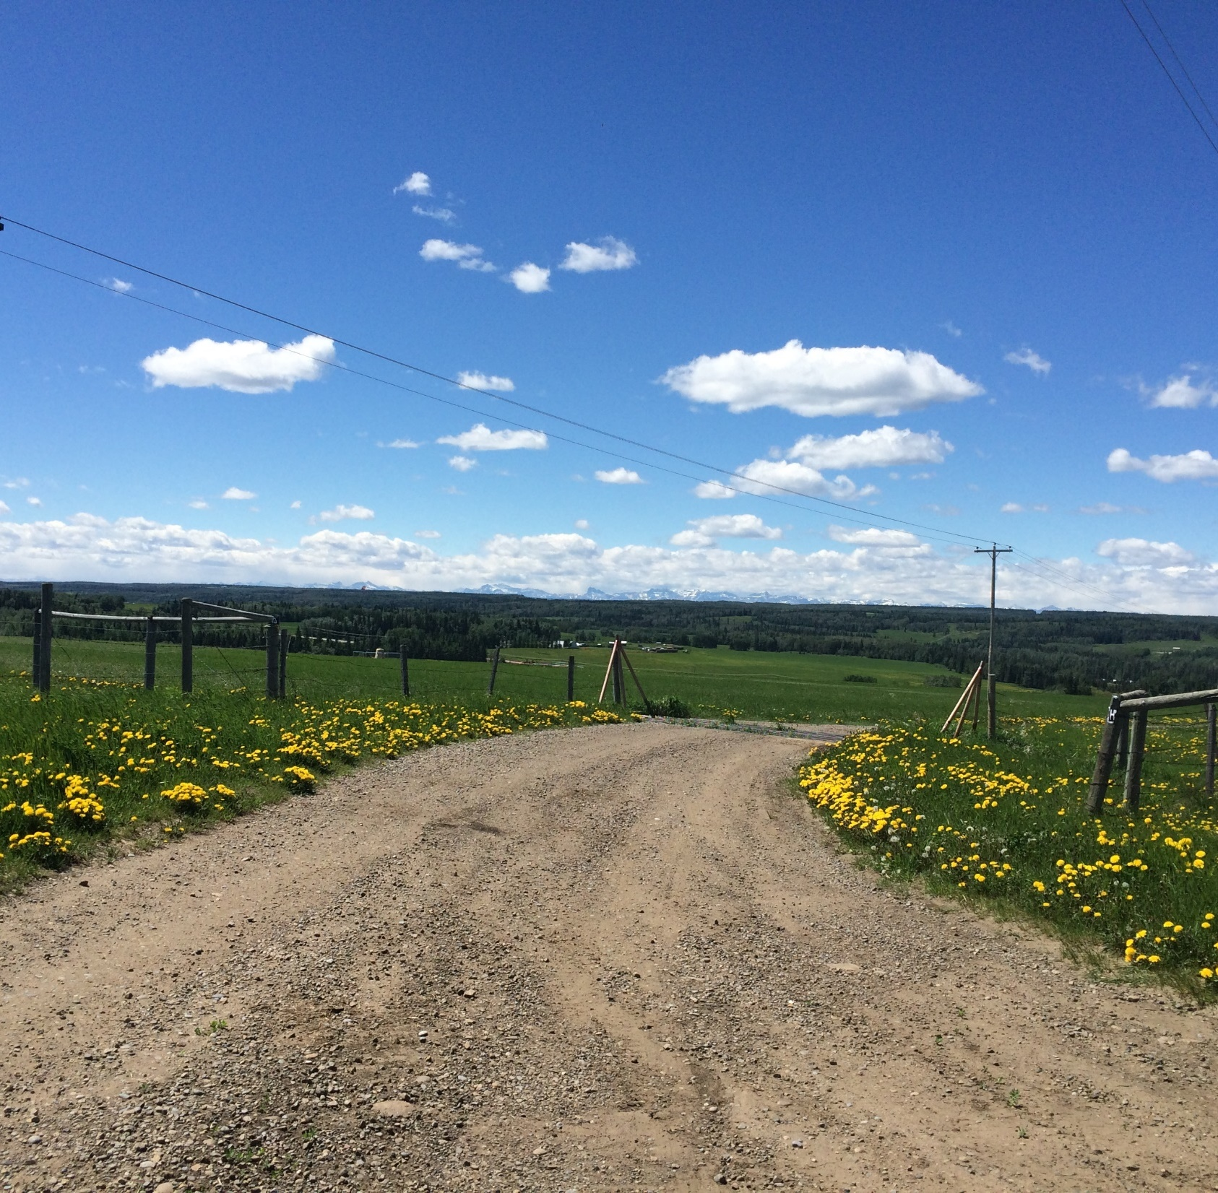
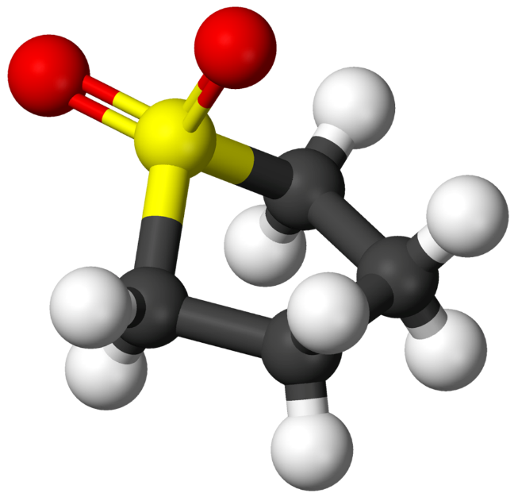
Project Context
Sulfolane Use OnSite
Gas plant removes H₂S from natural gas
Sulfolane : Industrial solvent used as a sweetening agent in sour gas processes
Historically used onsite from the 1960s to the 1980s
C₄H₈SO₂

Slide 4
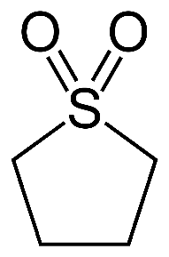
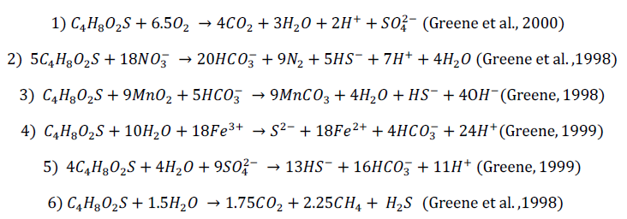

Sulfolane Properties
Sulfolane Fate and Transport
Low octanol/water partition coefficient = low adsorption in bedrock
Low vapor pressure and Henry’s Law Constant = not really volatile
Biodegradation under aerobic conditions – anaerobic degradation not confirmed in the field
Aerobic Degradation
Nitrate Reduction
Manganese Reduction
Iron Reduction
Sulphate Reduction
Methanogenesis

Slide 5
Pilot Test
Some of the main Challenges
Complex geology
Oxygen distribution in bedrock
Sulfolane degradation processes
Air injection in bedrock
Pulsing strategy
Multiple lines of evidence approach
to assess pilot test performances

Slide 6
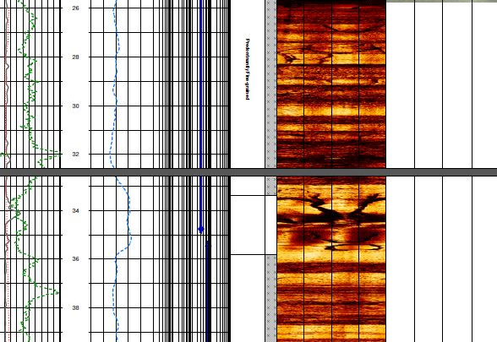
Conceptual Site Model

Slide 7
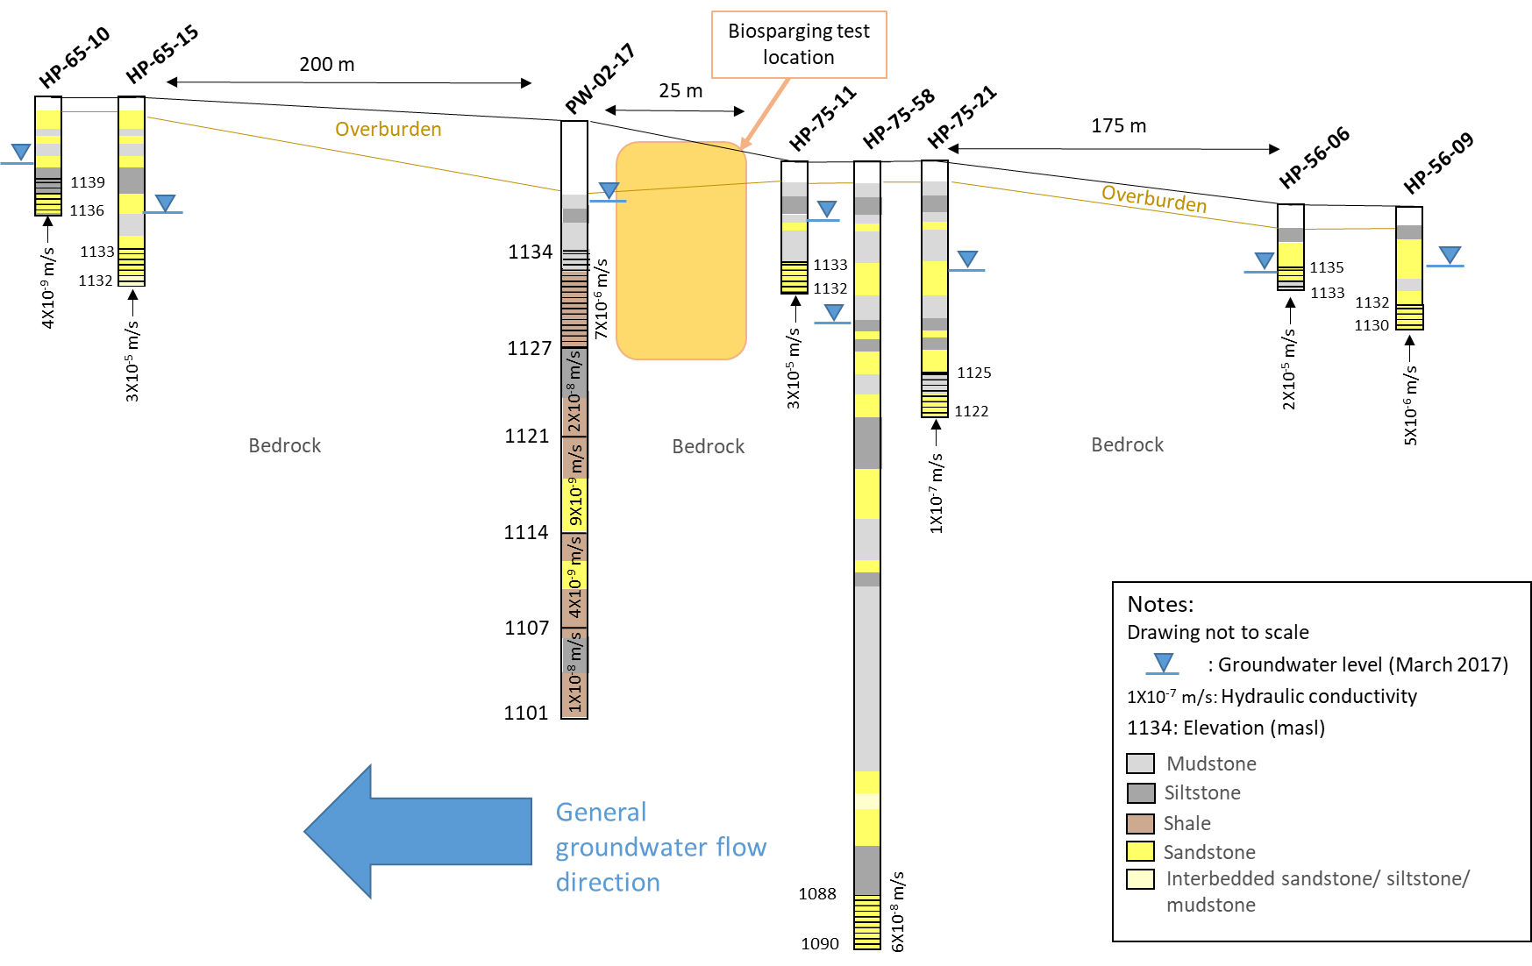
Pilot Test Area
Geology / Hydrogeology

Slide 8
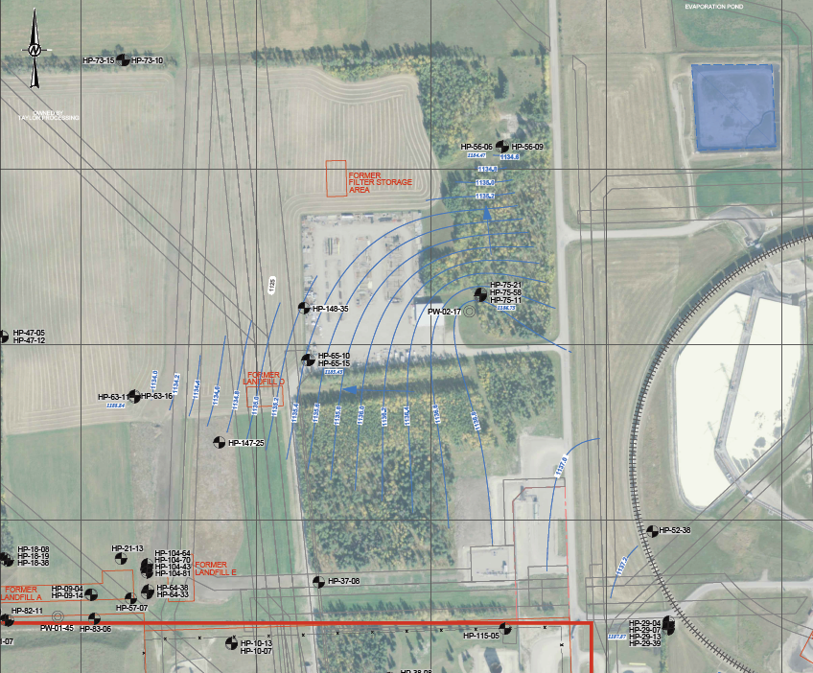
Pilot Test Area
Hydrogeology
Mean hydraulic conductivity
  7 X 10⁻⁶ m/s
Air injection step tests
  Main hydraulic connection appears to be horizontal
  Optimised air flow rate and injection pressure
Tracer test
  Confirmed hydraulic connection
  GW flow velocity 1.2 m/hr
Pilot Test Area
Groundwater flow direction

Slide 9
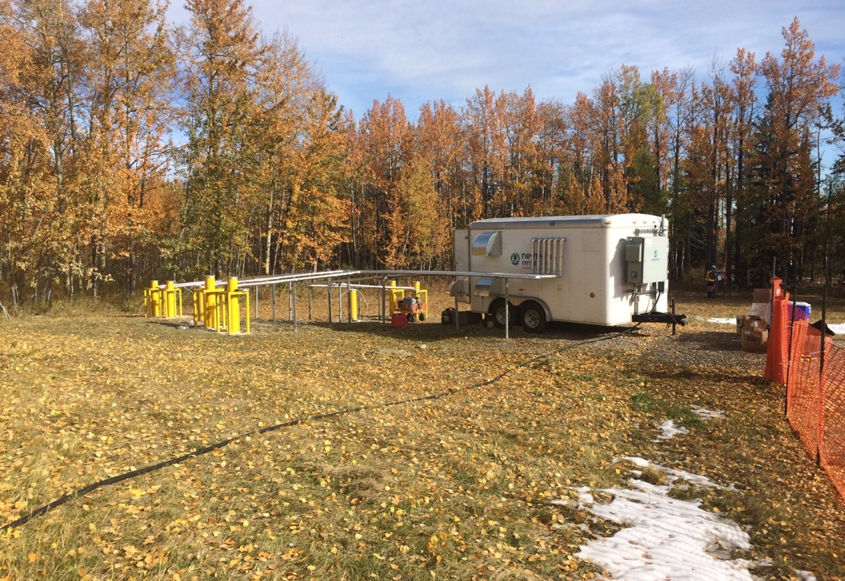
Pilot Test Configuration

Slide 10
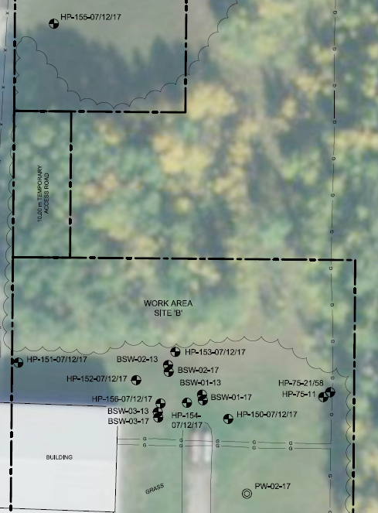
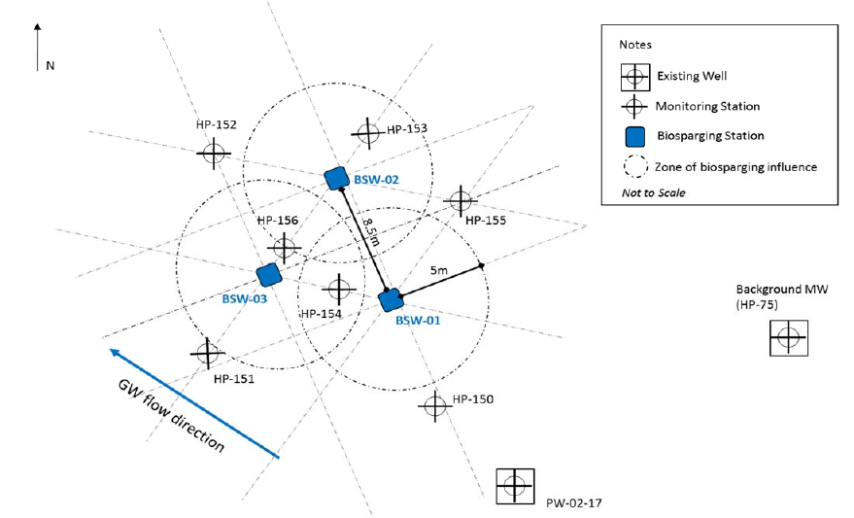
Pilot Test Configuration
Down-gradient wells
GW Flow
Direction
Overview
Biosparging Area Wells
Upgradient wells
Biosparging Wells
  12m Interval - 3 wells
  17m Interval – 3 wells
Monitoring Network
  7m Interval – 8 wells
  12m Interval – 14 wells
  17m Interval – 14 wells

Slide 11
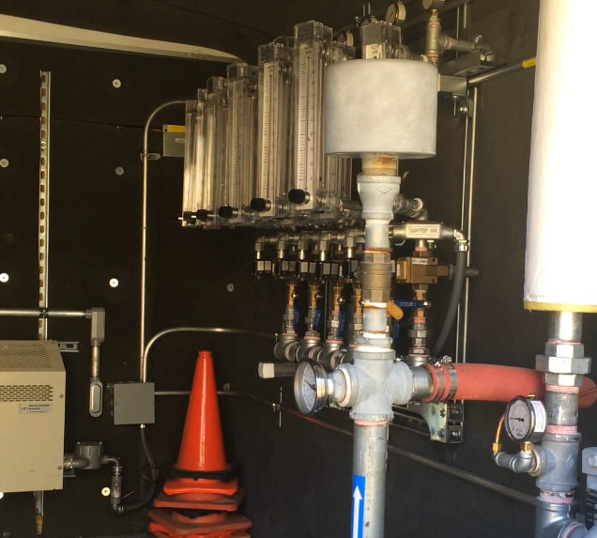
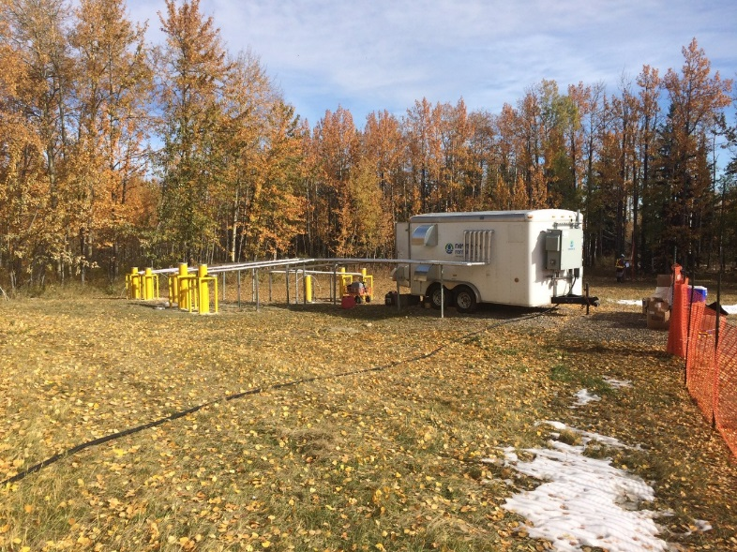
Pilot Test Configuration
System Performance
  Air flowrate
      0.5 scfm per well
  Air pressure
      4 to 7 psig (12m interval)
      6 to 11 psig (17m interval)
  Pulsing interval
      30 to 60 min
  Pilot test implemented from November 2017 and August 2018
Notes:
Discuss the successful optimization of the air flowrate and pressure settings
Further optimization needed to confirm pulsing frequency

Slide 12
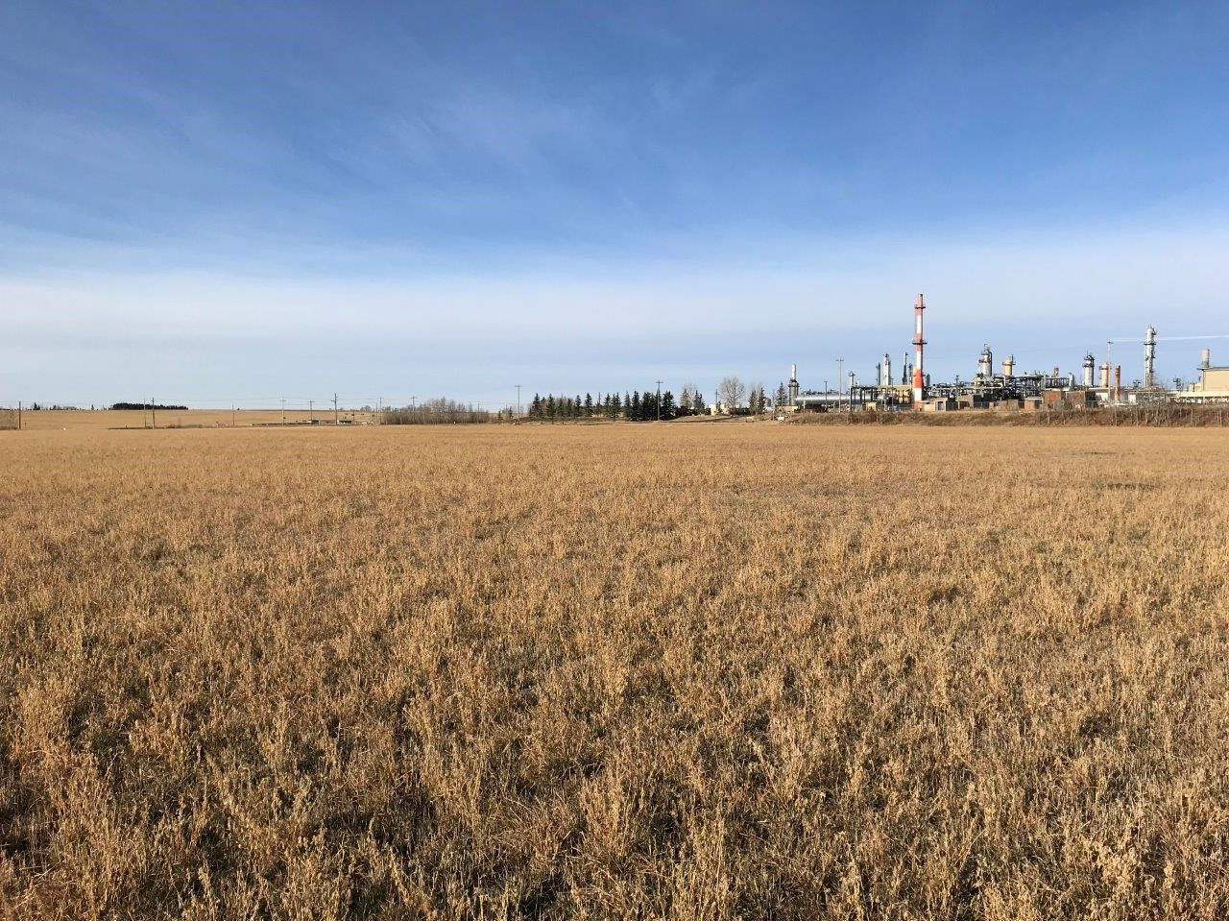
Results

Slide 13
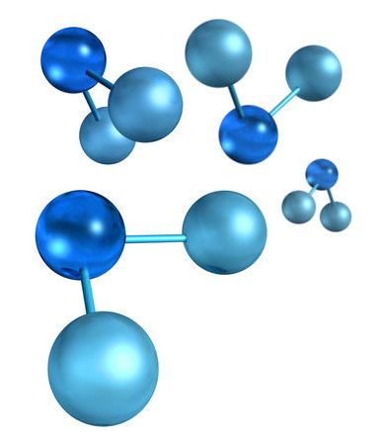
Performance Monitoring
Success Criteria
Mechanical operation of the system
Delivery of oxygen
Promotion of biodegradation of sulfolane

Slide 14
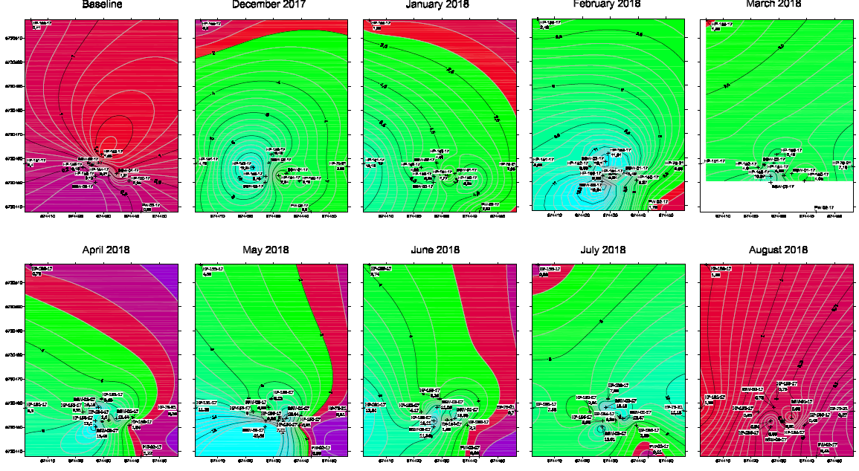
Dissolved Oxygen Concentrations – 17m Interval
Baseline
August 2017
December 2017
January 2018
February 2018
March 2018
April 2018
May 2018
June 2018
July 2018
August 2018
Notes:
Explain how the dissolved oxygen concentrations changed over time
July – pulsing frequency switched to inject mostly to atmosphere
August – System shut down due to electrical failure in late July

Slide 15
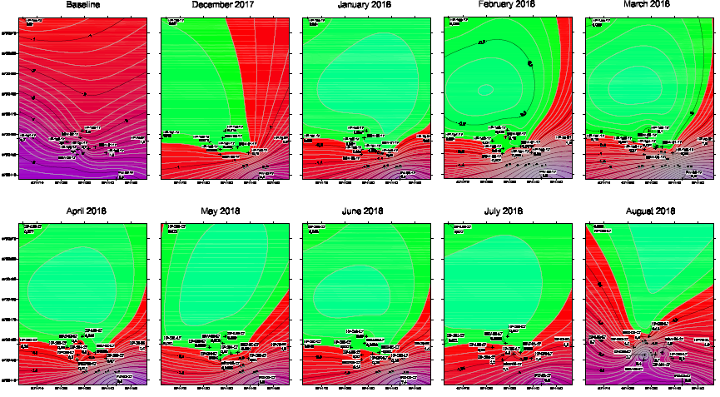
Sulfolane Concentrations – 17m Interval
Baseline
August 2017
December 2017
January 2018
February 2018
March 2018
April 2018
May 2018
June 2018
July 2018
August 2018
Notes:
Explain how the sulfolane concentrations changed over time

Slide 16
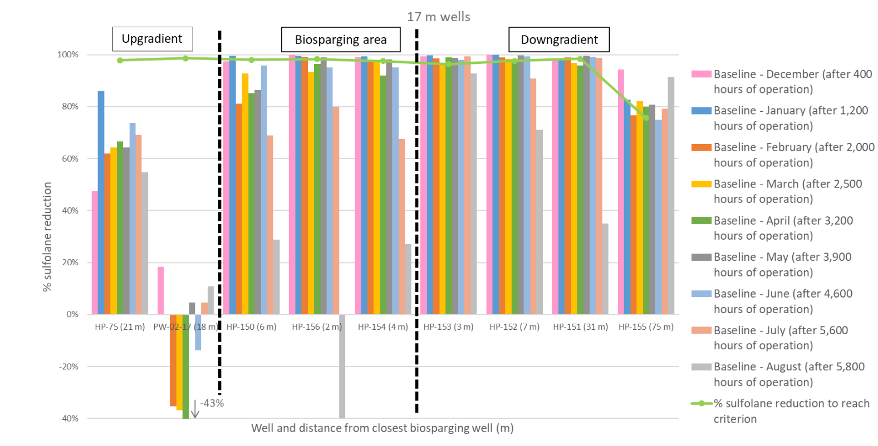
Sulfolane Reduction Results

Slide 17
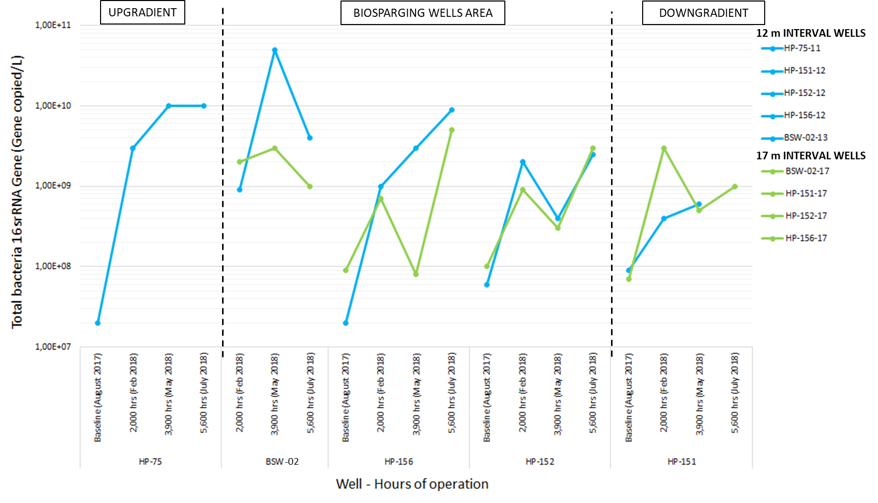
Total Bacteria by qPCR Results

Slide 18
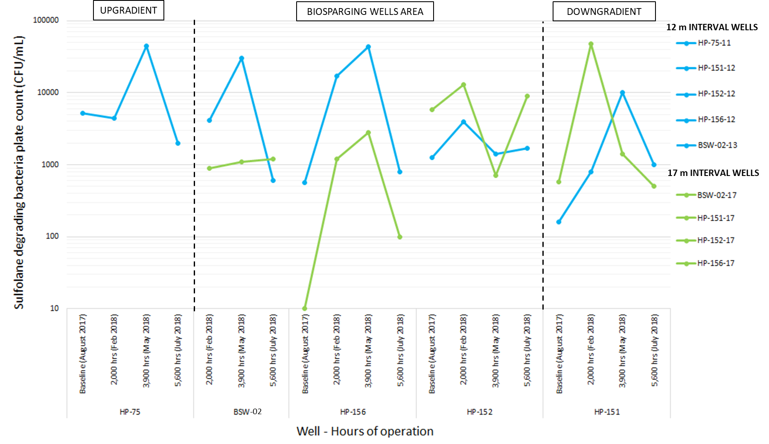
Sulfolane Degrading Bacteria Plate Counts Results

Slide 19

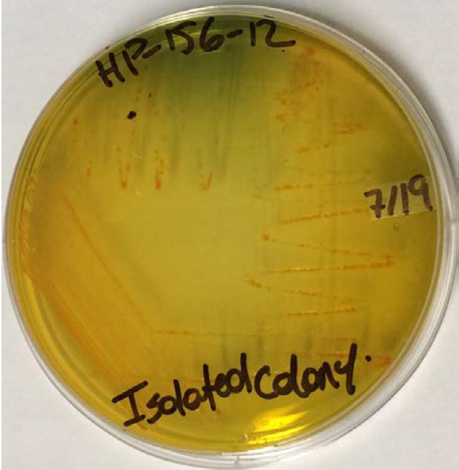
Colony Identification Results
Baseline
DNA sequences closely matched various Acidovorax species
6 Months
DNA sequences closely matched various Acinetobacter species
8 months
DNA sequences analyzed closely matched Acidovorax species

Slide 20
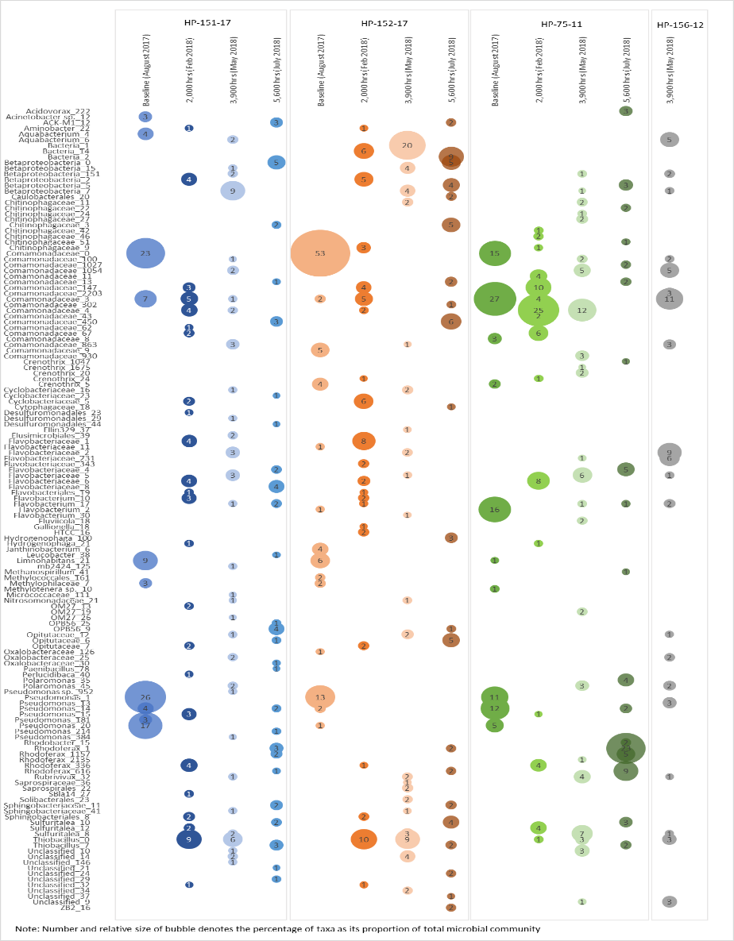
Next Generation Sequencing Results
August 2017
    184 OTUs
  February 2018
        893 OTUs
  July 2018
        1,646 OTUs
Sulfolane degraders
Nitrifying bacteria
Notes:
qPCR testing results confirmed a significant increase in microbial species density over time during the biosparging test
Substantial variability in the microbial communities between the samples.
Comamonadaceae (Acidovorax sp.) was one of the predominant families in the baseline event and was also confirmed present in all samples for all sampling events.
Acinetobacter sp. is one of the dominant species identified in the baseline samples. Its presence is also confirmed in samples recovered during all sampling events.
NGS results confirmed the presence of nitrifying bacteria in many samples for several sampling events

Slide 21
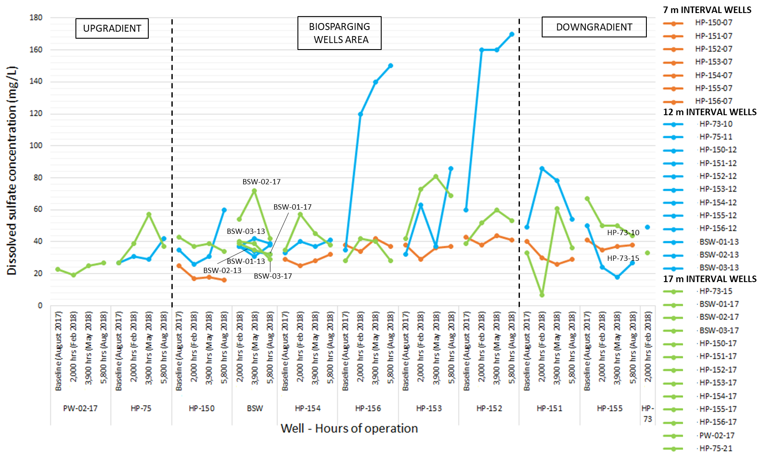
Dissolved SO₄ Results

Slide 22
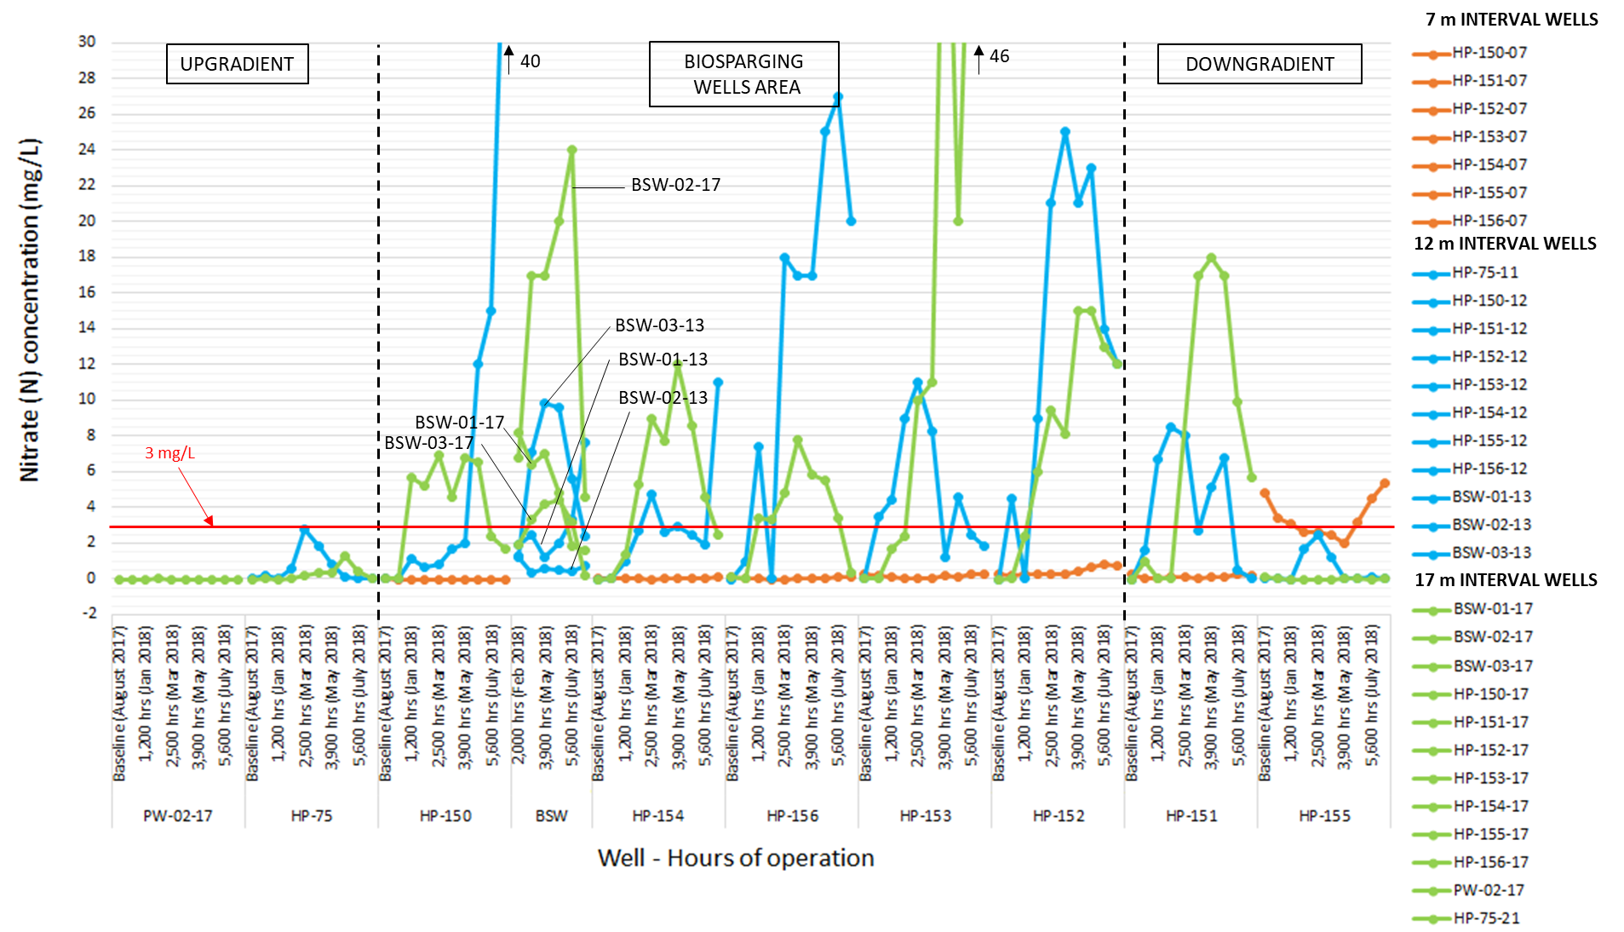
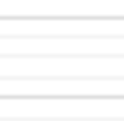


Dissolved NO₃ Results

Slide 23
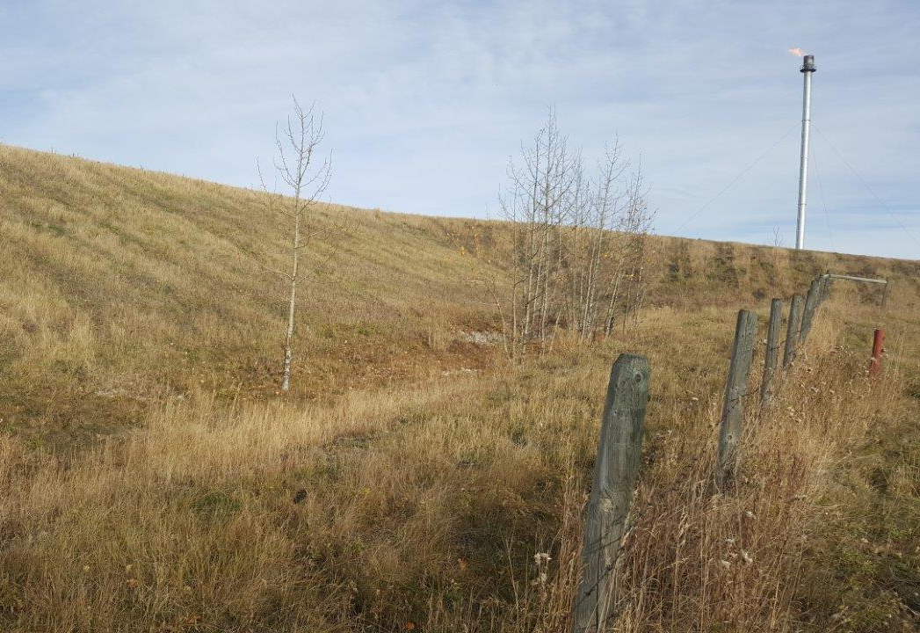
Conclusion

Slide 24
Conclusion
The oxygen delivery objective was maintained throughout the test.
The sulfolane biodegradation objectives were mostly met for the following indicators:
  Reduced dissolved sulfolane concentrations
  The presence of sulfolane degrading bacteria was confirmed and they increased over the course of the pilot
  The CO₂ and SO₄ concentrations were stable or increased
Notes:
The mechanical performance objectives were mostly met for the following operational parameters:
The air injection flowrate and injection pressure were successfully optimized.
The pulsing frequency was not fully optimized however, the pulsing frequencies used were within an acceptable range to lead to significant sulfolane removal.
The oxygen delivery objectives : 2 mg/L dissolved oxygen concentration was maintained throughout the test.
The sulfolane biodegradation objectives were mostly met for the following indicators:
The dissolved sulfolane concentrations were below the applicable guideline for most of the wells located in the biosparging and downgradient areas;
A significant decrease of sulfolane concentrations was observed in the biosparging wells and downgradient areas when compared to baseline conditions.
The sulfolane degrading bacteria concentrations increased in the biosparging wells and downgradient areas.
The next generation sequencing and colony ID analysis showed the presence of confirmed sulfolane degrading bacteria in the biosparging wells and downgradient areas.
The CO2 and SO4 concentrations were stable or increased in the biosparging wells and downgradient areas.

Slide 25
Next Steps
Air or oxygen delivery methods with possibly less of an influence on groundwater flow will be assessed for the site;
Improve understanding of nitrate production and potential impact for full-scale implementation of the technology;
Considering the positive microbial testing results obtained during this project, explore other lines of evidence such as additional microbiological studies at the sulfolane plume-scale to further understand and assess the extent and potential of monitored natural attenuation (MNA) and/or a combination of active remediation and MNA as viable site management strategies.

Slide 26
Acknowledgments
Imperial Oil Limited and ExxonMobil Environmental and Property Solutions
SiREM Labs – Microbial Testing and Technical Support
Newterra – Biosparging Unit Construction and Operation Support
Arcadis – Third-party review

